Slide 1




Energy Efficiency and Renewable Energy Impacts on NOx Emission Reductions in Texas
  Jeff Haberl, Ph.D.
  Juan-Carlos Baltazar, Ph.D., P.E.
  Bahman Yazdani, P.E.
November 10 - 18, 2020

Slide 2

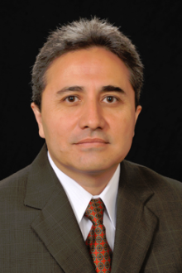











ACKNOWLEDGEMENTS
Faculty/Staff: Jeff Haberl, Juan-Carlos Baltazar, Bahman Yazdani, Gali Zilbershtein,
Shirley Ellis, Patrick Parker, Angela Rowell
Students: Sungkyun Jung, Farshad Kheiri, Qinbo Li, Chul Kim, Jounghwan Ahn, Mitra Azimi
              TCEQ: Bob Gifford
              PUCT: Therese Harris
              SECO: Eddy Trevino, Fred Yebra
              ERCOT: Paul Wattles, Connor Anderson
Notes:
This work is the team effort of Texas Emissions Reductions Program (TERP) at the Energy Systems Laboratory at Texas A&M, which includes (left to right):
Jeff Haberl, Juan-Carlos Baltazar, Bahman Yazdani, Gali Zilbershtein, Shirley Ellis, Patrick Parker, Angela Rowell and graduate students Sungkyun Jung, Farshad Kheiri, Qinbo Li,
Chul Kim, Jounghwan Ahn and Mitra Azimi.
This effort would not be possible without the effort of numerous individuals at other Texas State Agencies, including: Mr. Bob Gifford at the TCEQ; Ms. Therese Harris at the PUC
Texas; Mr. Eddy Trevino and Mr. Fred Yebra at SECO, and Mr. Paul Wattles and Connor Anderson at ERCOT.

Slide 3

LEGISLATION
Legislation to Reduce Energy/Emissions 2001 to Present
Senate Bill 5 (77th Legislature, 2001)
Ch. 386. Texas Emissions Reduction Plan
  Sec. 386.205. Evaluation Of State Energy Efficiency Programs (with PUC)
Ch. 388. Texas Building Energy Performance Standards
  Sec. 388.003. Adoption Of Building Energy Efficiency Performance Standards.
  Sec. 388.004. Enforcement Of Energy Standards Outside Of Municipality.
  Sec. 388.007. Distribution Of Information And Technical Assistance.
  Sec. 388.008. Development Of Home Energy Ratings.
TERP Amended (78th Legislature, 2003)
Ch. 388. Texas Building Energy Performance Standards
  (HB 1365) Sec. 388.004. Enforcement Of Energy Standards Outside Of Municipality.
  (HB 1365) Sec. 388.009. Energy-Efficient Building Program.
Ch. 388. Texas Building Energy Performance Standards
  (HB 3235) Sec. 388.009. Certification of Municipal Inspectors.
TERP Amended (79th Legislature, 2005)
Ch. 382. Health and Safety Code
  (HB 2129) Sec. 386.056 Development of Creditable Statewide emissions from wind and other renewables.
  (HB 965) Sec. 382.0275 Commission Action Relating to Water Heaters
TERP Amended (80th Legislature, 2007)
Ch. 382. Health and Safety Code
(HB 3693) Sec. 388.003 added subsection (b-1), (b-2), (b-3) that allows SECO to adopt new editions of the IECC based on written recommendations from the Laboratory.
(HB 3693) Sec. 388.008 Development of Standardized report formats for newly constructed residences.
Ch. 386.252 Health and and Safety Code
(SB 12) Section 388.03 added subsection (b-1), (b-2) allows SECO to adopt new editions of the IECC based on written recommendations from the Laboratory.
TERP Amended (81st Legislature, 2009)
Ch. 382. Health and Safety Code
  (HB 1796) Section 23 amends Sec. 386.252 (a) and (b) extends date of TERP to 2019 and requires Commission to contract with Laboratory for creditable EE/RE emissions reductions.
TERP Amended (82nd Legislature, 2011)
Ch. 477.004 Health and Safety Code
  HB 51 Section 2, b-2, establishes advisory committee, which including the Laboratory
  Section 3 & 4 amends review of municipal’s amendments.
Ch. 388.003e & 388.007c,d Health and Safety Code
  HB 51 Section 3 & 4 amends review of municipal’s amendments.
Ch. 388.006 Health and Safety Code
  SB 898 Section 2, requires the Laboratory to calculate energy savings and emissions reductions for political subdivisions reporting to SECO.
Ch. 39.9051 Utilities Code
  SB 924 Section 1g,h and Section 2c,d requires the Laboratory to calculate energy savings and emissions reductions for political subdivisions reporting to SECO.
  NO new amendments were passed (83rd Legislature, 2013)
  TERP Amended (84th Legislature, 2015)
  Section 388.003, Health and Safety Code
  HB 1736 Section 1 Establishes the 2015 energy codes as the TBEPS effective Sept 1, 2016. The state may adopt new codes no sooner than every 6 years. The section also adds Energy Rating Index as a voluntary compliance alternative.
NO new amendments were passed (85th Legislature, 2017)
NO new amendments were passed (86th Legislature, 2019)
Notes:
Texas has had Legislation since 2001 to reduce air pollution, which includes Energy Efficiency and Renewable Energy (EE/RE).
These begin with the original legislation in the 77th Legislature in 2001 – Senate Bill 5.
This was followed by amendments in the 78th Legislature in 2003;
Amendments in the 79th Legislature in 2005;
Amendments in the 80th Legislature in 2007;
Amendments in the 81st Legislature in 2009;
Amendments in the 82nd Legislature in 2011;
Amendments in the 83rd Legislature in 2013; and
Amendments in the 84th Legislature in 2015.
No new amendments were passed in the 85th Legislature (2017) and 86th Legislature (2019)

Slide 4
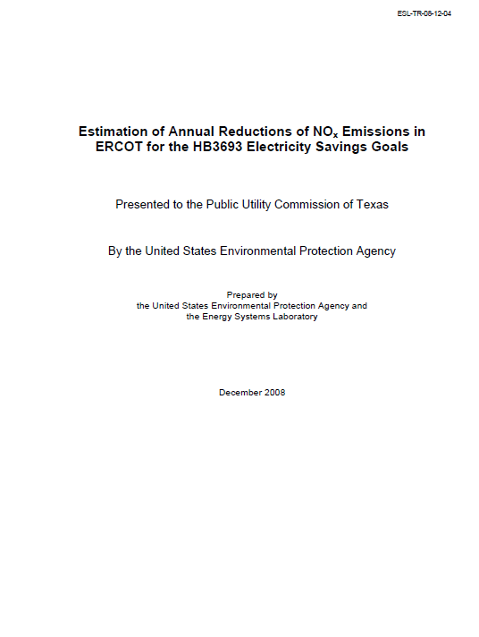
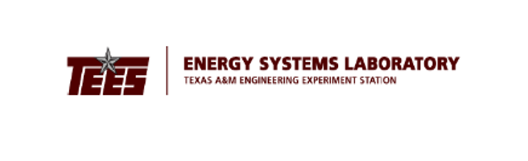
EPA CRITERIA FOR SIP CREDITS (2004)
Quantifiable: The emission reductions generated by measures to reduce emissions must be quantifiable and include procedures to evaluate and verify over time the level of emission reductions actually achieved.
Surplus: Emission reductions are surplus as long as they are not otherwise relied on to meet air quality attainment requirements in air quality programs related to your SIP.
Enforceability: Measures that reduce emissions from electricity generation may be: (1) Enforceable directly against a source; (2) Enforceable against another party responsible for the energy efficiency or renewable energy activity; or (3) Included under our voluntary measures policy.
Record Keeping: The measure should be permanent throughout the term for which the credit is granted unless it is replaced by another measure or the State demonstrates in a SIP revision that the emission reductions from the measure are no longer needed to meet applicable requirements.
Notes:
Currently, the State of Texas follows the Criteria set forth by the U.S.E.P.A. in 2004 for determining State Implementation Credits (SIP).
These credits certify that the emissions reductions are Quantifiable, Surplus, Enforceable and that proper Record Keeping is performed.
Quantifiable: The emission reductions generated by measures to reduce emissions must be quantifiable and include procedures to evaluate and verify over time the level of emission reductions actually achieved.
Surplus: Emission reductions are surplus as long as they are not otherwise relied on to meet air quality attainment requirements in air quality programs related to your SIP.
Enforceability: Measures that reduce emissions from electricity generation may be: (1) Enforceable directly against a source; (2) Enforceable against another party responsible for the energy efficiency or renewable energy activity; or (3) Included under our voluntary measures policy.
Record Keeping: The measure should be permanent throughout the term for which the credit is granted unless it is replaced by another measure or the State demonstrates in a SIP revision that the emission reductions from the measure are no longer needed to meet applicable requirements.

Slide 5

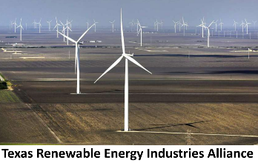


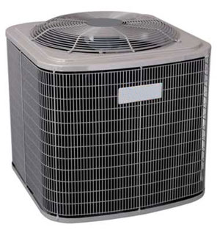
ENERGY SAVINGS & NOx EMISSION REDUCTION
ESL Calculates & Reports NOx Emissions Reductions for:
1. Code-Compliant Construction: Energy savings from new construction
Single-family construction
Multi-family construction
Commercial construction
2. Green Power Production: Wind and other renewables
3. PUC SB7: Energy efficiency programs implemented by electric utilities under the Public Utility Regulatory Act §39.905
4. SECO: Energy-efficiency programs towards school districts, government agencies, city and county governments, private industries and residential energy consumers
5. A/C Retrofits: Installation of SEER 13/14 replacement air conditioners in existing residences
Notes:
The Energy Savings and NOx Emissions Reduction From Energy Efficiency and Renewable Energy are calculated from five areas:
1. Code-Compliant Construction: Energy savings from new construction: Single-family construction, Multi-family construction, Commercial construction
2. Green Power Production: Wind and other renewables
3. PUC SB7: Energy efficiency programs implemented by electric utilities under the Public Utility Regulatory Act §39.905
4. SECO: Energy-efficiency programs towards school districts, government agencies, city and county governments, private industries and residential energy consumers
5. A/C Retrofits: Installation of SEER 13/14 replacement air conditioners in existing residences

Slide 6
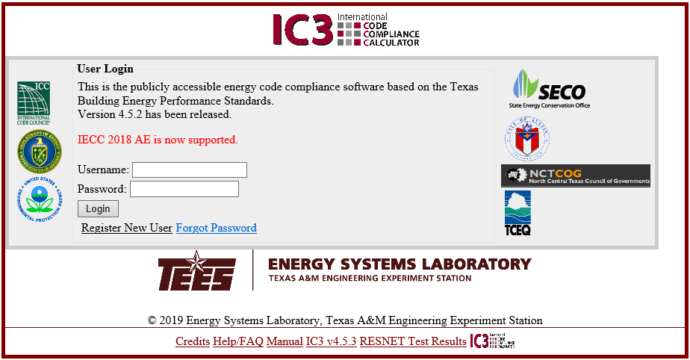
ENERGY SAVINGS & NOx EMISSION REDUCTION
ESL Calculates & Reports NOx Emissions Reductions for:
Code-Compliant Construction: Energy savings from new construction
Login Screen
Notes:
The Energy Savings and NOx Emissions Reduction From Single-Family Residential New Construction is calculated with the assistance of the publically-available International Code Compliance Calculator (IC3), which was developed by the Energy Systems Laboratory.
This is the LOGIN screen for IC3.

Slide 7
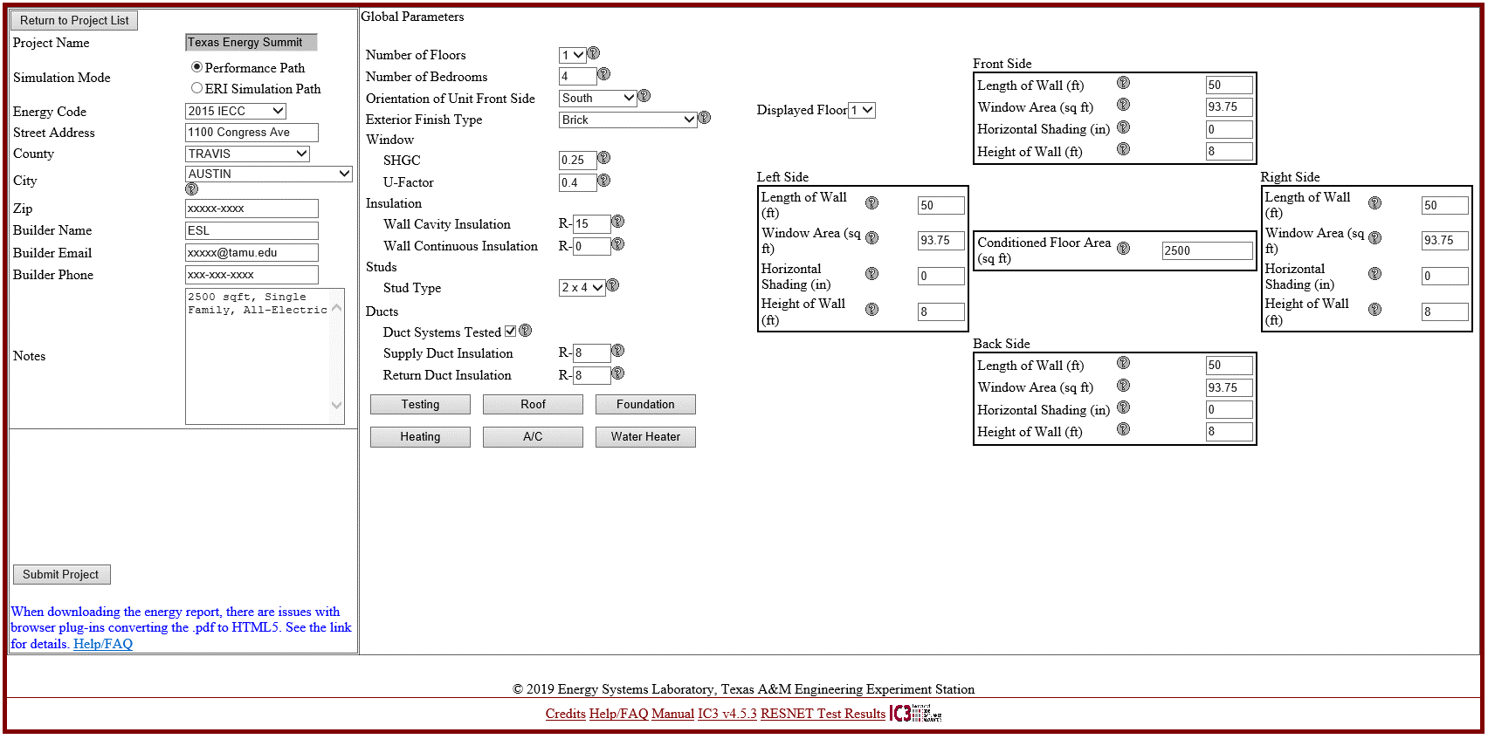
ENERGY SAVINGS & NOx EMISSION REDUCTION
ESL Calculates & Reports NOx Emissions Reductions for:
Code-Compliant Construction: Energy savings from new construction
Main Page
Notes:
This is the main data entry screen for IC3, which includes general information about the project (i.e., address, building name, phone number, etc.).
It also provides a choice as to whether the IC3 user chooses to follow the “performance path” or the “ERI Simulation Path” for code-compliance with the IECC.
On the right side of the screen are inputs that describe the house, including: number of floors, bedrooms, window information, details about the insulation levels, ductwork, and the dimensions of the house.
Six additional tabs are included so the user can enter information about: infiltration testing, roof, foundation, heating system, cooling system, and the domestic water heater.
Each of these inputs also have a “help” tab where the user can go to get help about what is being entered.

Slide 8
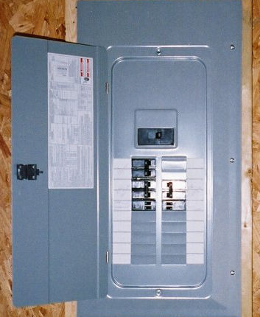
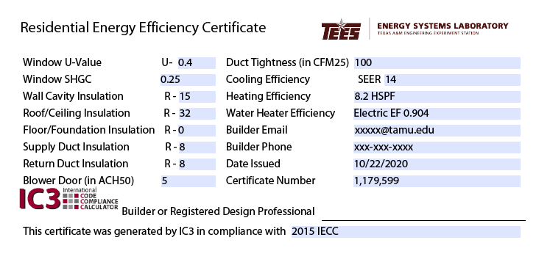
ENERGY SAVINGS & NOx EMISSION REDUCTION
ESL Calculates & Reports NOx Emissions Reductions for:
Code-Compliant Construction: Energy savings from new construction
IC3 Prints Certificate for Posting on Electrical Panel
Records Certificate in IC3 Registry
Prints Certificate for Electrical Panel
Notes:
Once the information is entered, and the house complies with the IECC energy code a certificate is generated that can be posted on the electrical panel of the house. This certificate is then entered into the IC3 Registry that is maintained at the ESL.

Slide 9




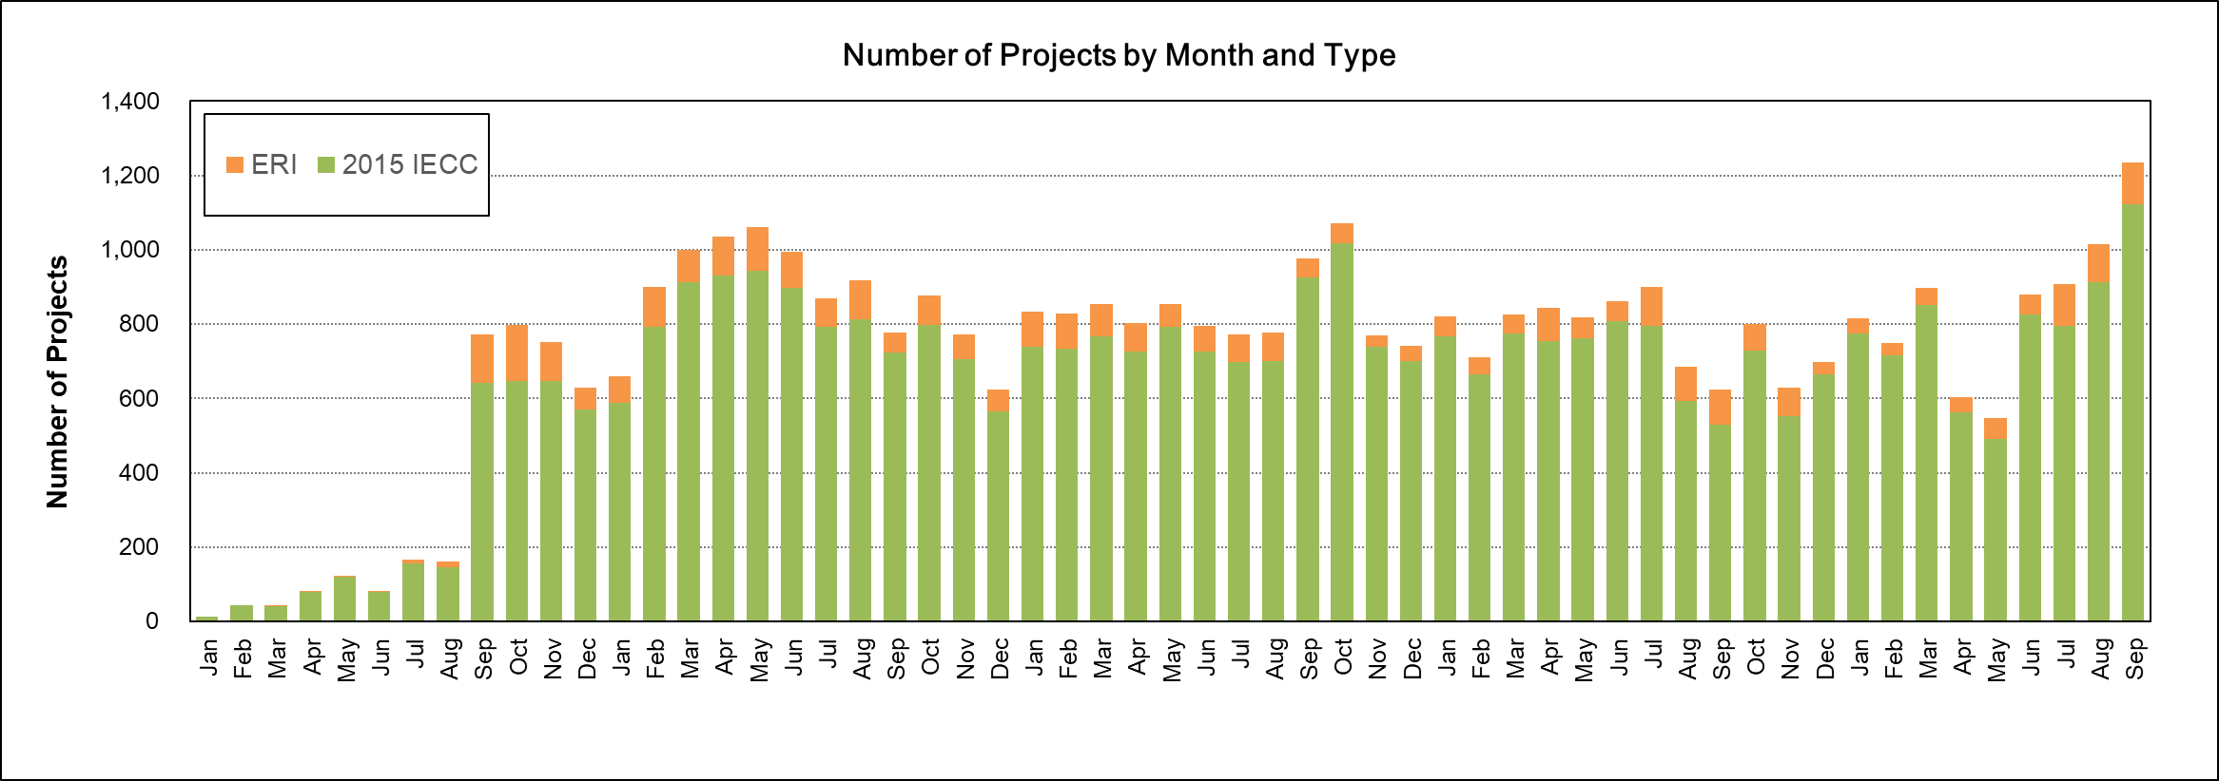




STATEWIDE SAVINGS FROM CODE COMPLIANCE
How much electricity has been saved from residential code compliance for all single-family housing 2000-2020?
Projects/Certificates
in IC3 Registry
2016
2017
2018
2019
2020
Notes:
Since 2001 the IECC has been updated seven times, including: the 2001 Supplement, the 2003 IECC, 2006 IECC, 2009 IECC, 2012, 2015 IECC and most recently the 2018 IECC.
Since its inception, the ESL has been recording the certificates generated by IC3. This graph shows the number of certificates generated from the 2015 IECC onward, including those certificates that followed the performance path (green) and those certificates that followed the ERI path (orange).
The graph on this slide shows the certificates through September of 2020, which includes a drop in usage by COVID-19 in April and May, which picked-up again in June and continued pretty much business as usual through September. Depending on the month, there are usually about 800 to 1,000 IC3 certificates issued each month (about 26 to 33 per day, 7 days per week).

Slide 10
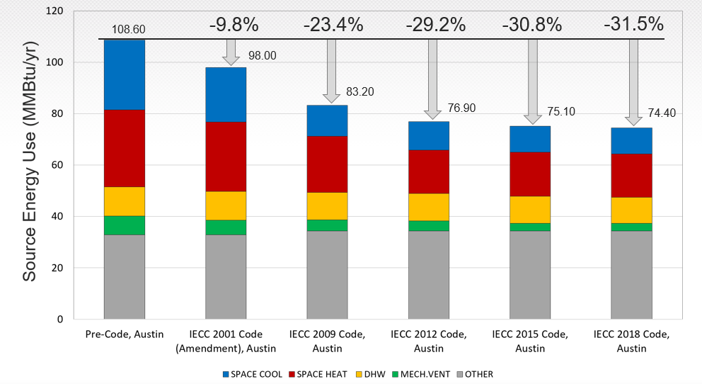
How much residential code compliances have saved in Austin, TX (Climate Zone 2A) from 1999 to 2020?
2,500 ft² SF House
Wall: R-11 to R13
Roof: R-26 to R-38
Win Uvalue: 1.11 to 0.40
Win SHGC: 0.71 to 0.25
SEER: 10 to 14
AFUE: 0.80 to 0.82
HSPF: 6.8 to 8.2
DHW EF: 0.86 to 0.95
Notes:
Since the 2000/2001 IECC was adopted by the state of Texas in 2001 there have been significant changes to the Residential Energy Building Code.
For example, in Austin, SOURCE energy use for a 2,400 ft2 single family residence, built to code has decreased by 31.5% (Pre-code to IECC 2018).
+ The Wall R-Value has gone from R-11 to R-13, the Roof insulation has gone from R-26 to R-38.
+ The Window U-factor has gone from 1.11 to 0.40, Window SHGC has gone from 0.71 to 0.25
+ The SEER from 10 to 14,
+ AFUE from 0.8 to 0.82,
+ HSPF from 6.8 to 8.2,
+ DHW EF from 0.86 to 0.95

Slide 11
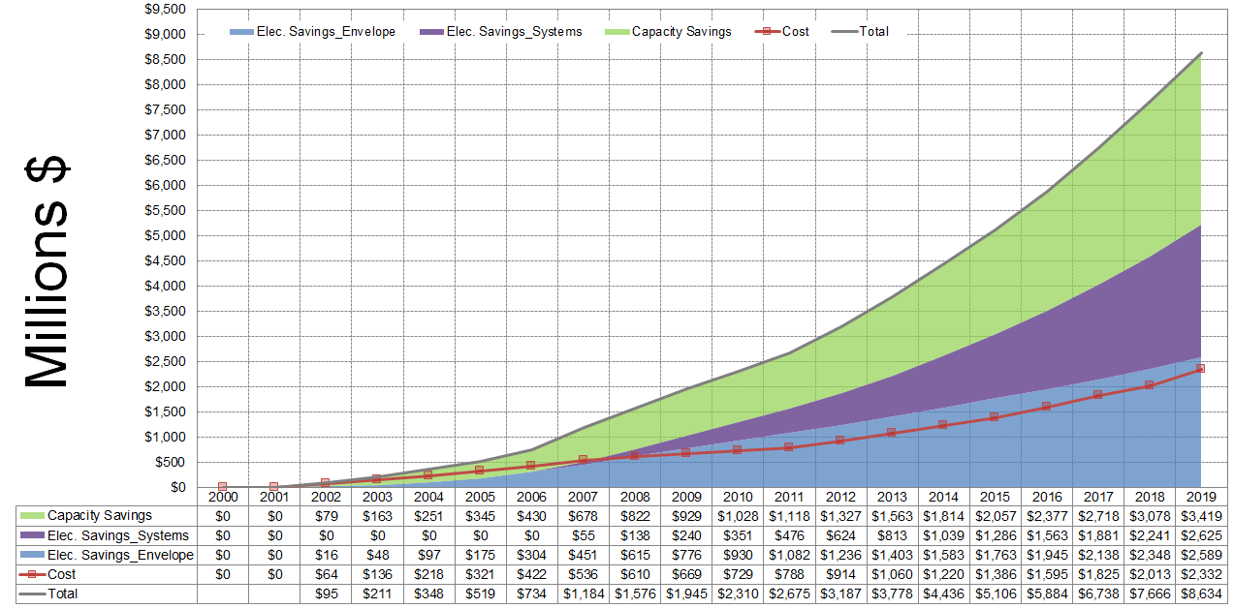
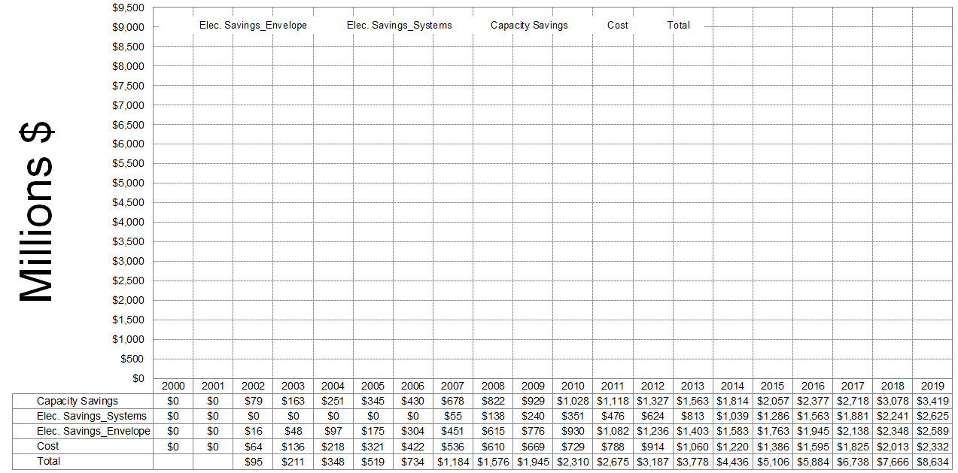
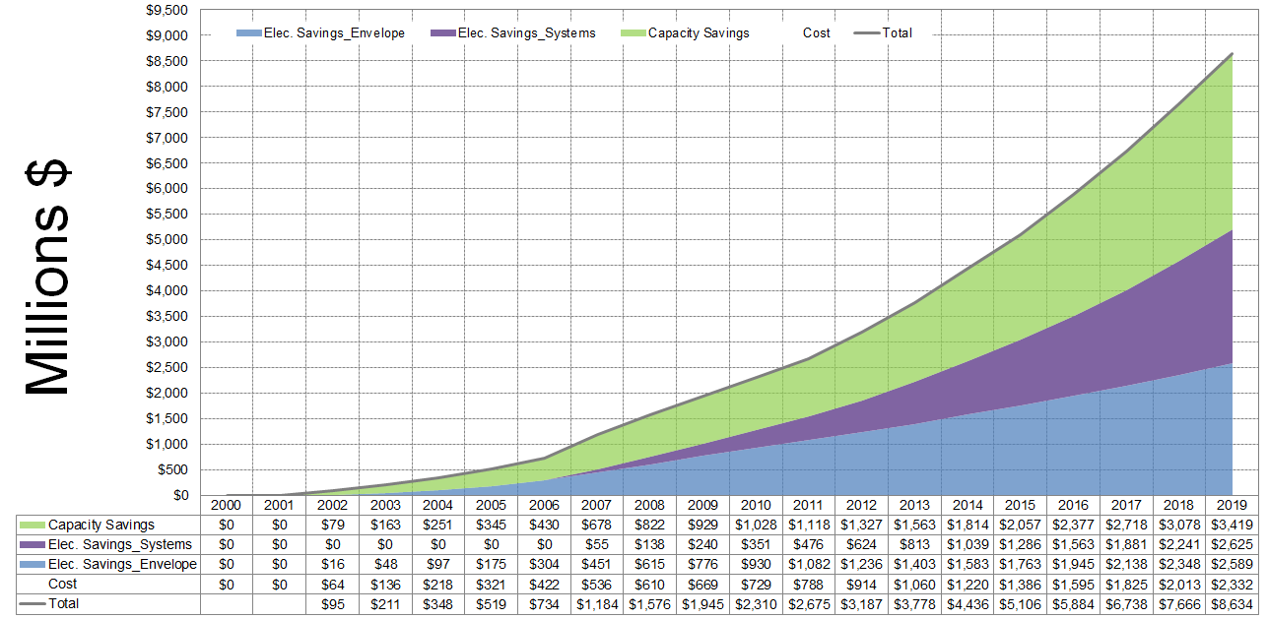
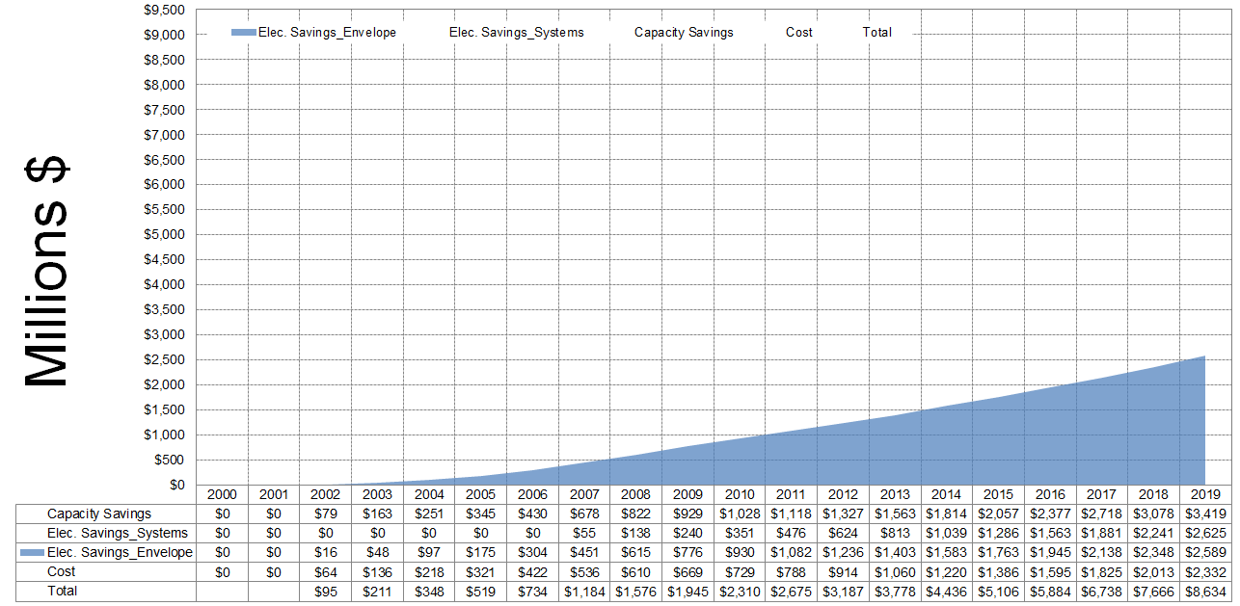
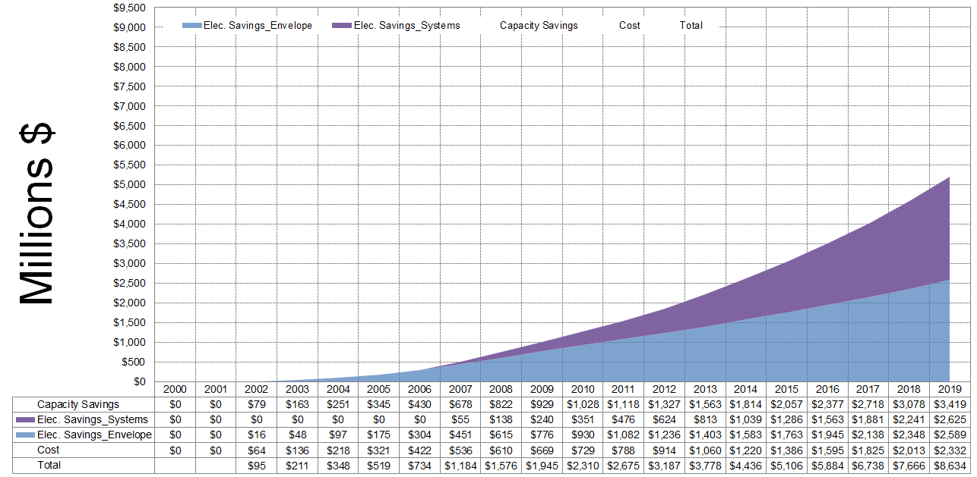
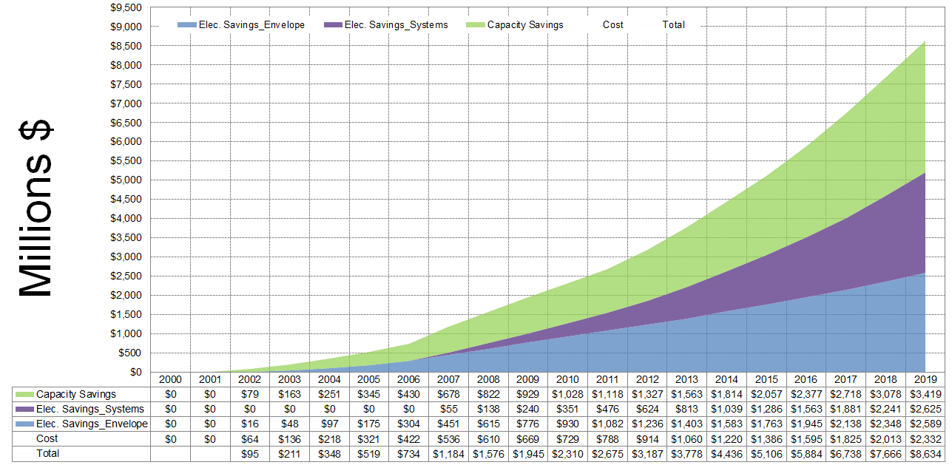
STATEWIDE SAVINGS FROM CODE COMPLIANCE
2000 – 2019 (ESTIMATED)
Savings (2002 to 2018)
Total: $7,672 million
Increased Costs (2002 to 2019)
Costs: $ 2,332 million
Savings (2002 to 2019)
Electricity (Envelope): $2,589 million (+10.8%)
Electricity (HVAC Systems): $2,625 million (+16.3%)
Demand: $3,419 million (+11.1%)
Total: $8,634 million (+12.5%)
NOx Emissions Reduction (2019)
105.85 tons NOx / year
(Equivalent to about 80,472 cars)
Total: $8,634 million
Demand: $3,419 million
Millions $
Electricity (HVAC Systems): $2,625 million
Cost: $2,332 million
Electricity (Envelope): $2,589 million
Notes:
Statewide the financial savings from the improved residential energy efficiency has been calculated from 2002 through 2019. These savings represent direct and indirect cost savings that homeowners did not have to pay because their homes cost less to heat, light and cool when compared to homes built before 2001.
Savings (2002 to 2018)
Total: $7,672 million
Savings (2002 to 2019)
Electricity (Envelope): $2,589 million (+10.8%)
Electricity (HVAC Systems): $2,625 million (+16.3%)
Demand: $3,419 million (+11.1%)
Total: $8,634 million (+12.5%)
…i.e., total savings = $8,634 which is 12.5% more than 2018.
Increased Costs (2002 to 2019)
Costs: $ 2,332 million
NOx Emissions Reduction (2019)
105.85 tons NOx / year
Emissions Reduction in 2019
(Equivalent to about removing 80,472 cars from the roads of Texas)

Slide 12
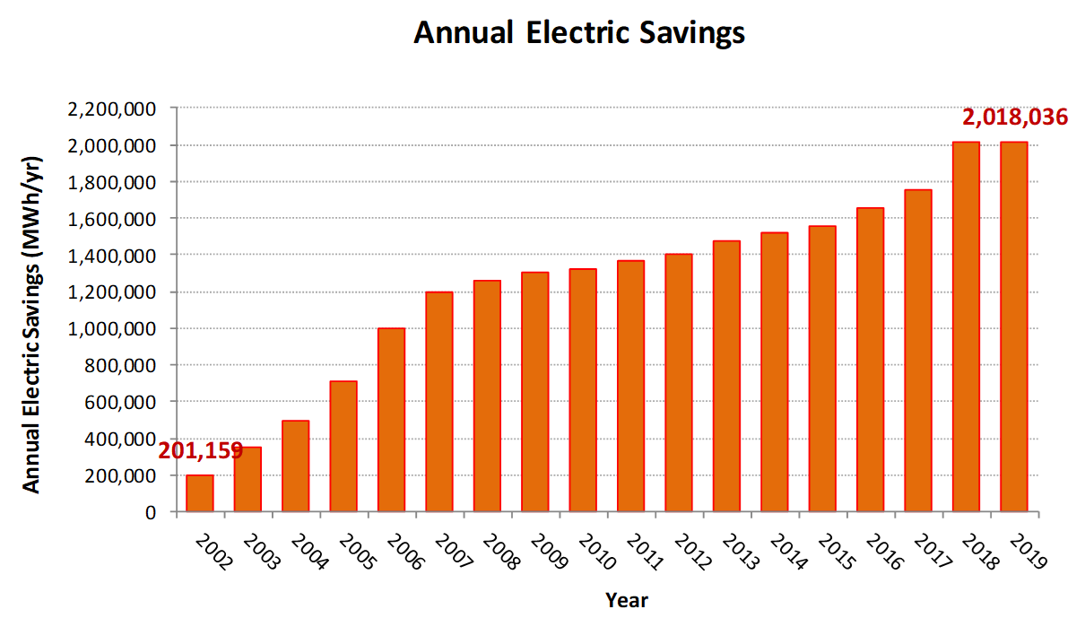
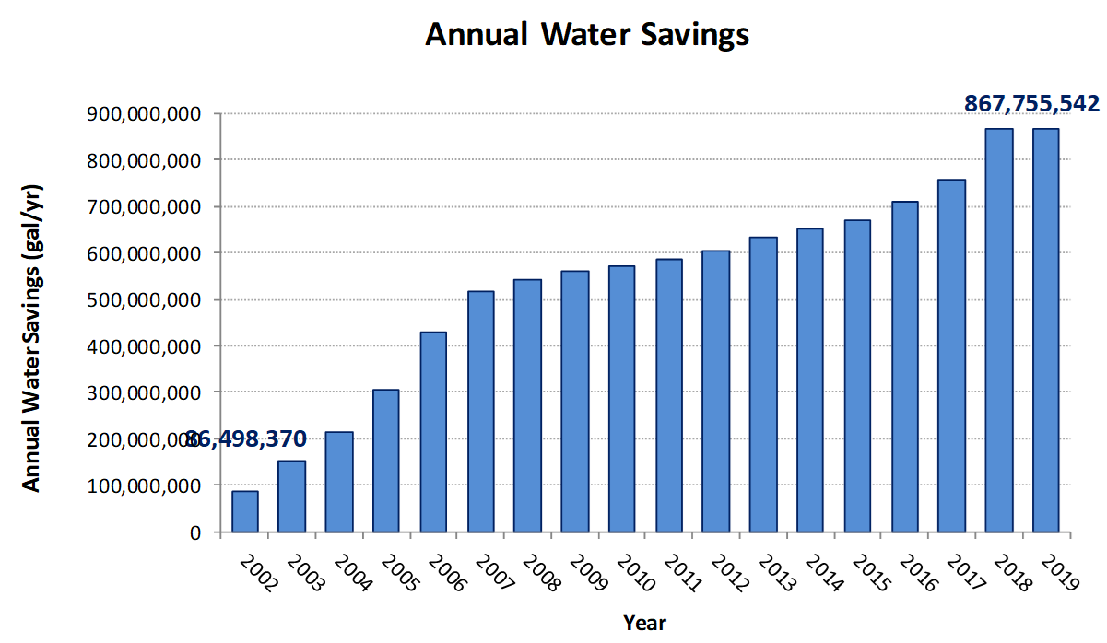
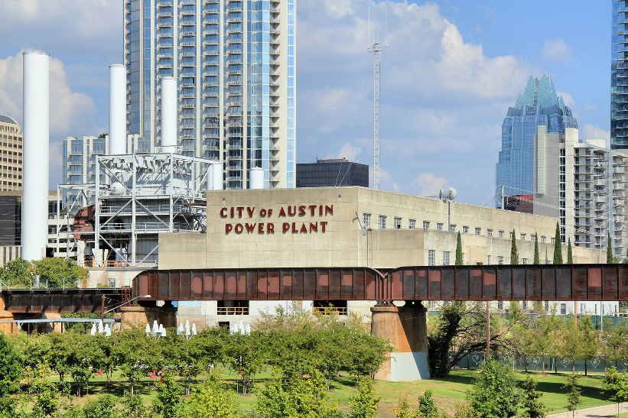
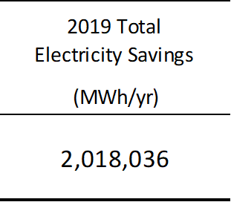
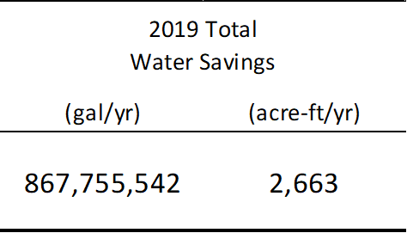
STATEWIDE WATER SAVINGS AT POWER PLANTS
2000 – 2019
Electricity/Water Savings from SF (Code Compliance)
Seaholm Power Plant, Austin
Conversion Factors: 430 gal/MWh
325,851 gal/acre-ft
Notes:
This much electricity savings has resulted in reduced water use by the combustion-based, electric power plants.
In 2019, Statewide electricity savings from the Single Family Code Compliance has reached 2,018,036 MWh/yr, which equates to 867,755,542 gallons/year, 99,058 gallons per hour, or 2,318 acre-ft/yr.

Slide 13
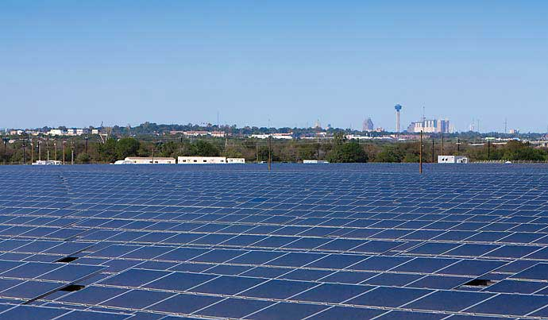
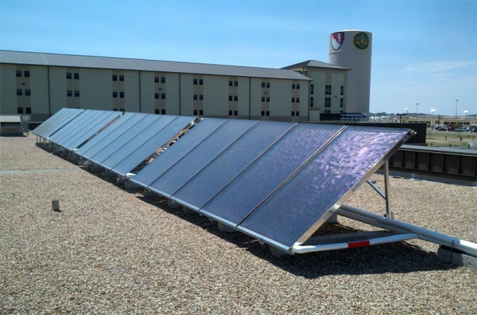
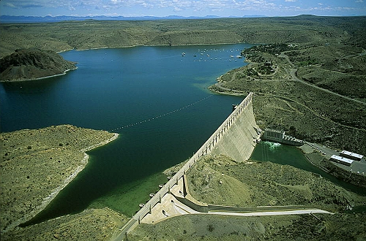
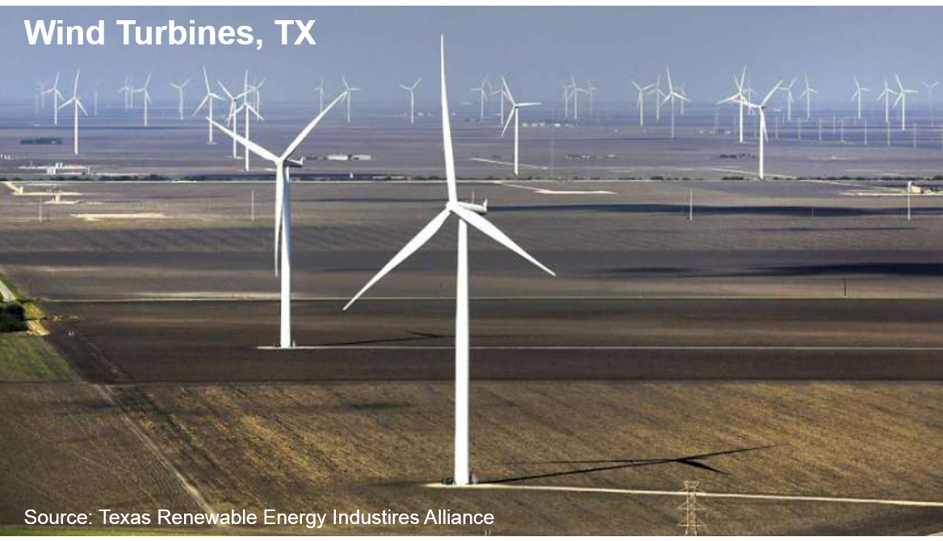
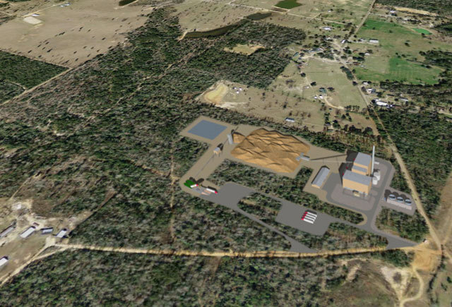
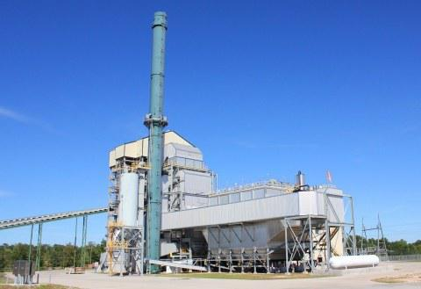
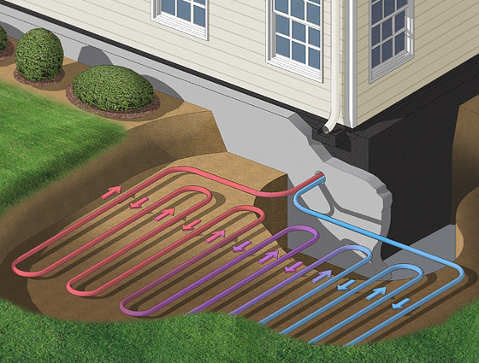
SAVINGS FROM RENEWABLES
Blue Wing Solar PV Array, San Antonio, TX
Sunmaxx Solar Thermal, Fort Hood, TX
Dam at Elephant Butte, El Paso, TX
Solar PV
Solar Thermal
Hydro
2.5 Miles Southwest of Woodville, TX
Aspen Power plant in Lufkin, TX
Ground Source Heat Pump
Biomass
Landfill Gas
Geothermal
Notes:
Texas has also had significant NOx emission reductions from the growing amount of renewable energy generated Statewide.
These include: solar PV, solar thermal, hydroelectric, biomass, landfill gas and geothermal sites.

Slide 14
WIND PROJECTS IN TEXAS (2019)
Completed Wind Projects in Texas, as of Jan. 2020
ERCOT: Electric Reliability Council of Texas
WSCC: Western Systems Coordinating Council
SPP: Southwest Power Pool
Number of Completed Projects: 167
(26,714 MW)
Notes:
In 2019 the number of completed projects equaled 167 (26,714 MW) Statewide with the majority of the projects in ERCOT and the Southwest Power Pool (SPP).

Slide 15
WIND PROJECTS IN TEXAS (2019)
Announced and Retired Wind Projects in Texas, as of Jan. 2020
ERCOT: Electric Reliability Council of Texas
WSCC: Western Systems Coordinating Council
SPP: Southwest Power Pool
MISO: Midcontinent Independent System Operator
Number of Announced Projects: 136
(28,686 MW)
Number of Retired Projects: 4
(156 MW)
Notes:
As of January 2020 the number of Announced Wind Projects equaled 136 (28,686 MW). In addition, 4 projects (156 MW) were retired.

Slide 16
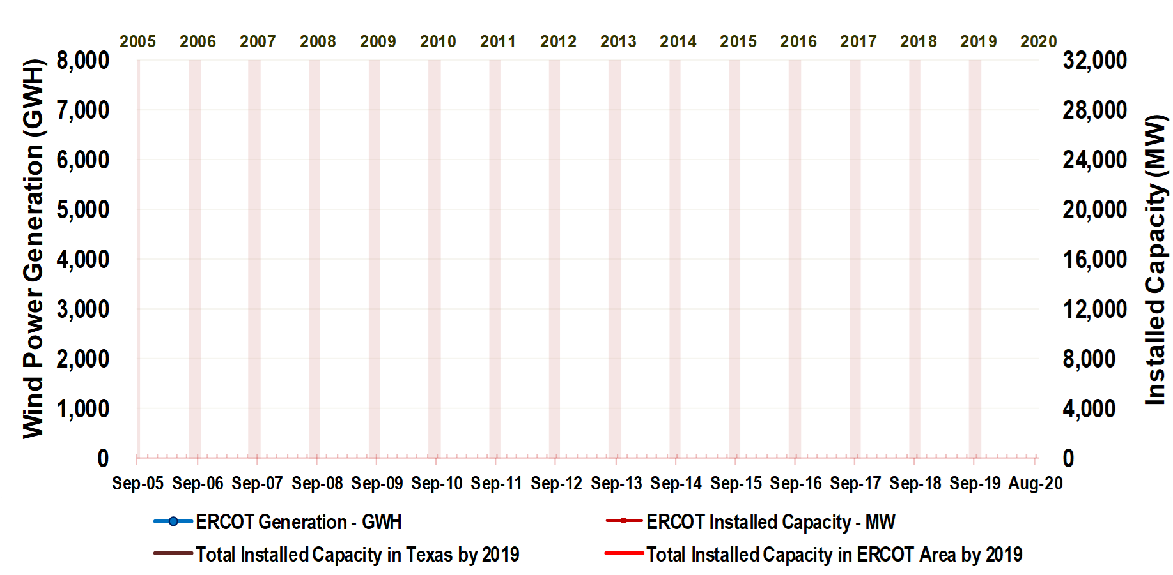
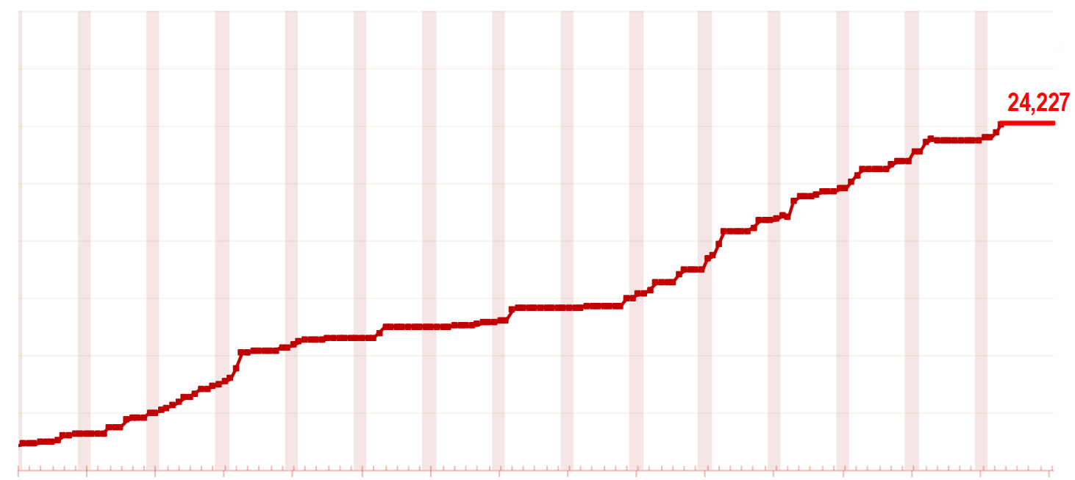
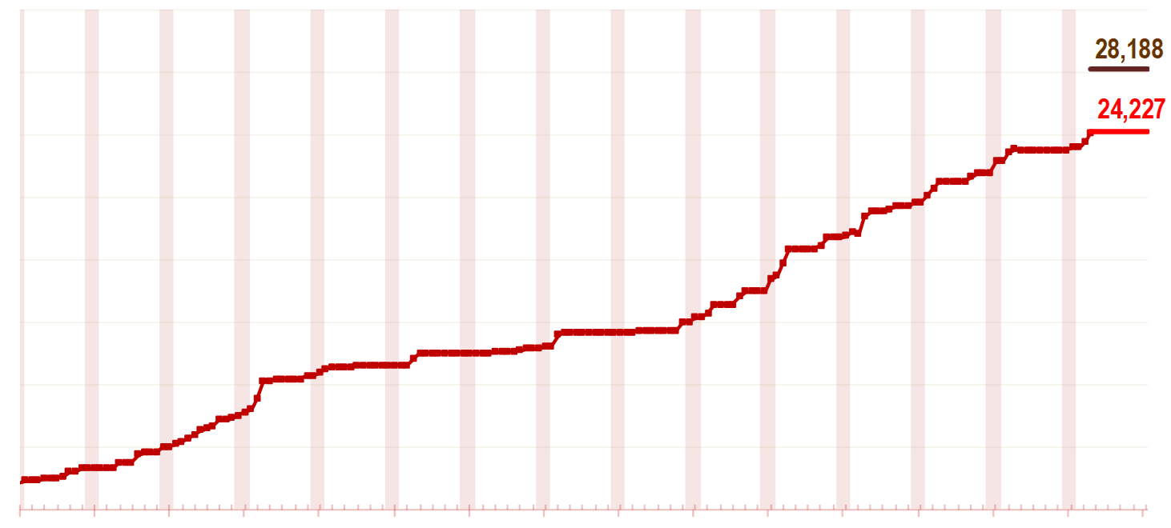
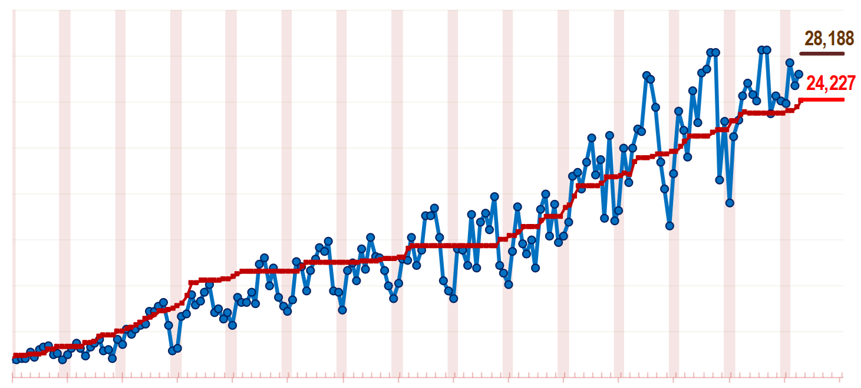
WIND PROJECTS IN TEXAS (2019)
ERCOT Capacity 24,227 MW
Total Capacity 28,188 MW
Total Wind Power 71,694 GWh
6,592 on Dec. 2019
24,227 on Dec. 2019
Notes:
By December 2019 the total ERCOT installed capacity was 24,227 MW, and the total capacity Statewide was 28,188 MW.
The total wind power generated in 2019 was 69,898 GWh (ERCOT) and 71,694 GWh (Statewide).

Slide 17
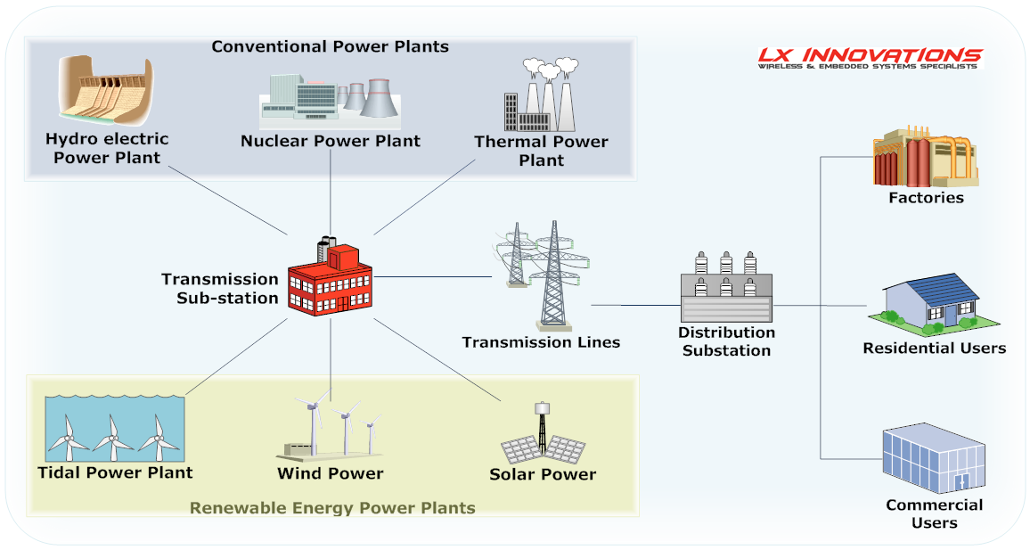
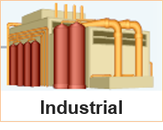

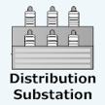
NOx REDUCTIONS USING eGRID
NOx emissions reductions calculation from electricity savings
_{CONSUMPTION}
  Energy Savings from EE/RE Programs
  Residential
  Commercial
  Industrial
_{TRANSMISSION & DISTRIBUTION}
  Transmission Lines
  Sub-Station
_{GENERATION}
  Energy Production & Emissions Reductions
  Conventional
  Renewable
Notes:
The total NOx emission reductions from energy efficiency and renewable energy is calculated using a process called displaced emissions.
First, the conventional electricity generation (thermal, hydro, nuclear) is mapped onto the ERCOT transmission grid along with the renewables (wind, solar (PV & thermal power), as well as tidal power plants (future). This electricity is then traced down to the local distribution stations where it serves residential, commercial and industrial customers.
Then the electricity savings from code-compliance in residential, commercial and industrial utility customers AND the electricity generated from renewables sources is added together to displace the electricity that was not generated by the combustion of fossil fuels for the baseyear determined by TCEQ and EPA.
Sometimes it is easier to understand this process with a diagram like this.

Slide 18
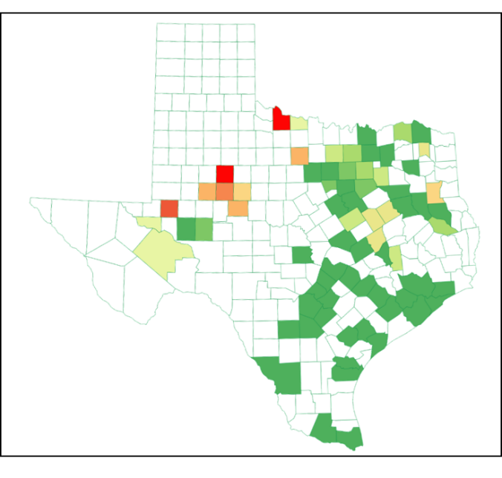
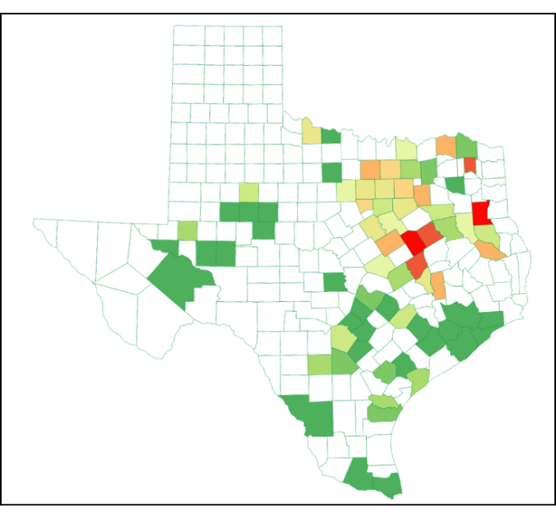
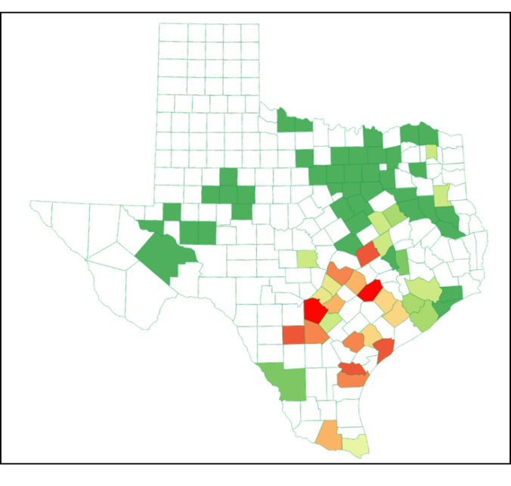
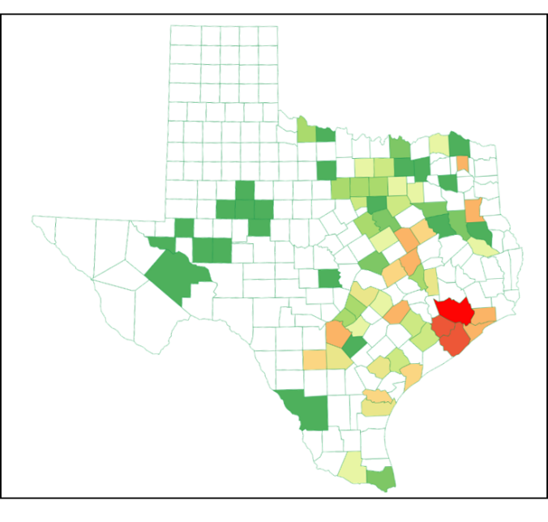
New 2016 eGRID for NOx Emissions
New 2016 eGRID (Annual) for NOx Emissions – ERCOT Region
Unit: lbs of NOx/MWh
West Zone
North Zone
South Zone
Houston Zone
Notes:
To calculate the NOx emissions reductions we use the 2016 version of the USEPA’s Emissions & Generation Resource Integrated Database (eGRID).
eGRID 2016 is the national database of air pollution or emissions data from electric power plants, which includes:, the lbs/MWh for NOx, SOx, CO2 and other pollutants for 2016, which is the version of eGRID chosen by the Texas Commission on Environmental Quality (TCEQ).
`
This slide shows the 2016 eGRID Annual NOx emissions by the West, North, South and Houston ERCOT load zones. In the map the red or orange counties represent those counties with a large concentration of NOx emissions (lbs/MWh) from electric power production facilities in that county.
A similar map of the NOx emissions (lbs/MWh) during the Ozone Season Period (OSP) is also maintained for the ERCOT loads zones.

Slide 19
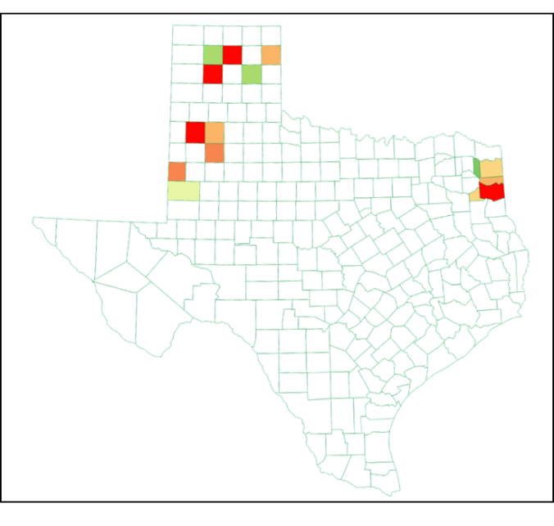
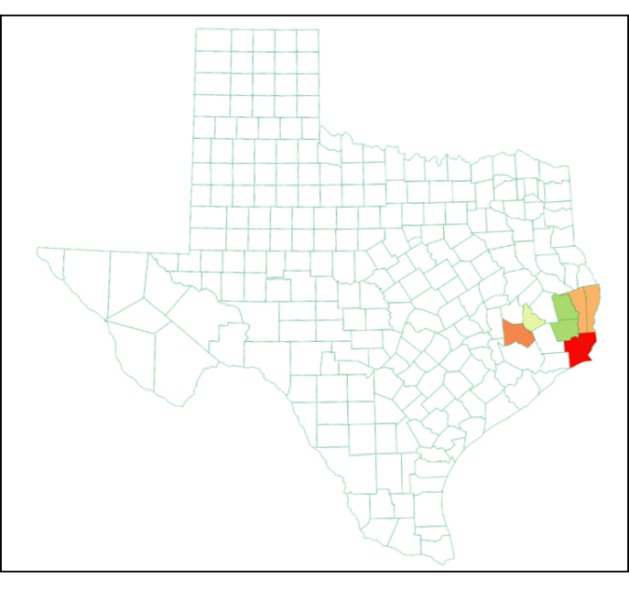
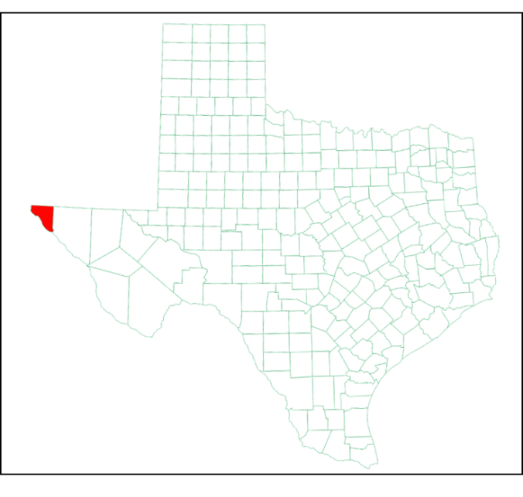
New 2016 eGRID for NOx Emissions
New 2016 eGRID (Annual) for NOx Emissions - New Regions
Unit: lbs of NOx/MWh
SPP
SERC
ERCOT: Electric Reliability Council of Texas
SPP: Southwest Power Pool
SERC: Southeastern Electric Reliability Council
WECC: Western Electricity Coordinating Council
WECC
Notes:
This slide shows 2016 Annual NOx emissions (lbs/MWh) for the Southwest Power Pool (SPP), Southeastern Electric Reliability Council (SERC), and Western Electricity Coordinating Council (WECC) load zones in Texas.
A similar map of the NOx emissions (lbs/MWh) during the Ozone Season Period (OSP) is also maintained for the SPP, SERC and WECC load zones.

Slide 20
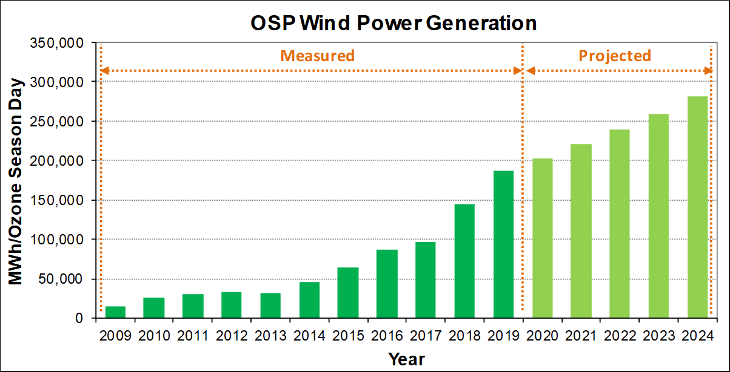
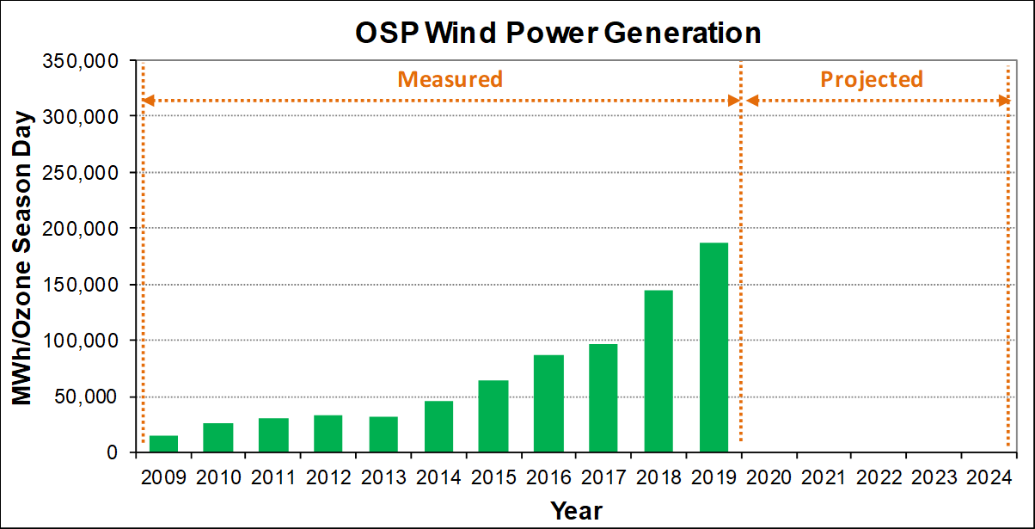
NOx REDUCTIONS FROM WIND POWER
OSP Power Generation and NOx Emissions Reductions (2008 base year)
281,069
↑ 8.4% / year
187,283
↑ 29.1%
145,064
↑ 50.4%
96,466
Source: 15-min Wind Generation Data from ERCOT
OSP: The Ozone Season Period (OSP): May 1 - Sep 30
Notes:
This slide shows the measured OSP electric power generation (MWh/OSD) for 2018 and 2019, with projections through 2024 that use an 8.4% per year growth rate. These electricity power generation calculations are weather-normalized to the 2008 baseyear (determined by TCEQ and EPA).
As shown on the graph there was a 50.4% increase in the electricity generated by wind from 2017 to 2018 and a 29.1% increase from 2018 to 2019 resulting in 187,283 MWh/OSD.
By 2024 the electricity generated by wind is expected to grow to 281,069 MWh/OSD.

Slide 21
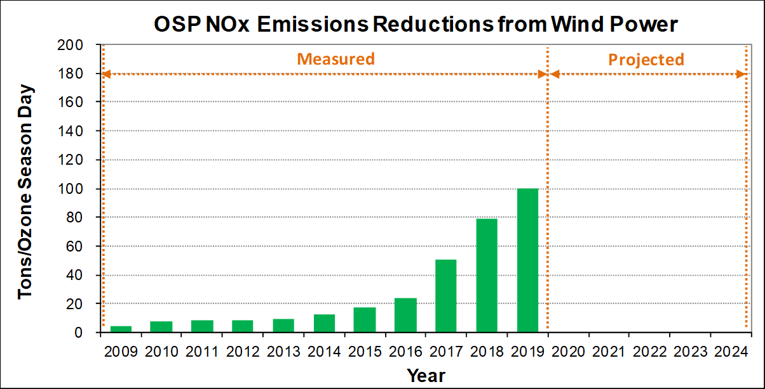
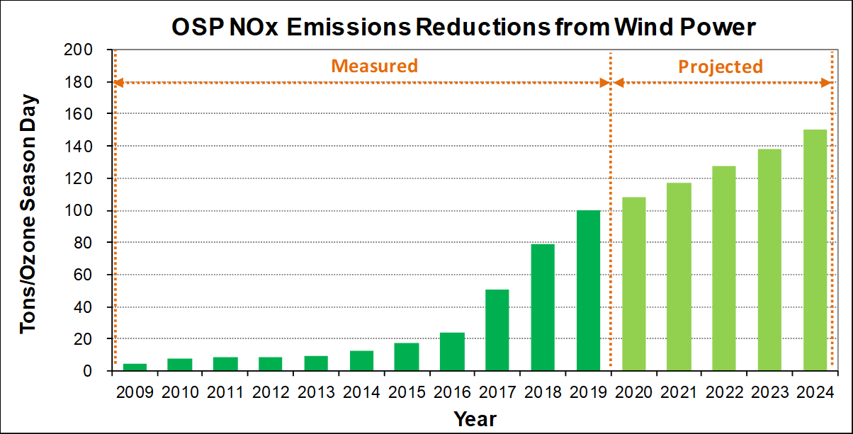
NOx REDUCTIONS FROM WIND POWER
OSP Power Generation and NOx Emissions Reductions (2008 base year)
↑ 8.4% / year
150
100
↑ 26.5%
79
↑ 56.8%
50
Source: 15-min Wind Generation Data from ERCOT
Notes:
Using eGRID the MWh/OSD is translated into NOx emissions, which yields tons of NOx/OSD for all ERCOT, SPP, SERC and WECC load zones.
In 2017 this amounted to 50 tons of NOx/OSD, which grew to 79 tons of NOx/OSD in 2018 and 100 tons of NOx/OSD by 2019. This is expected to grow at 8.4% per year, which would amount to 150 tons/NOx/OSD.

Slide 22
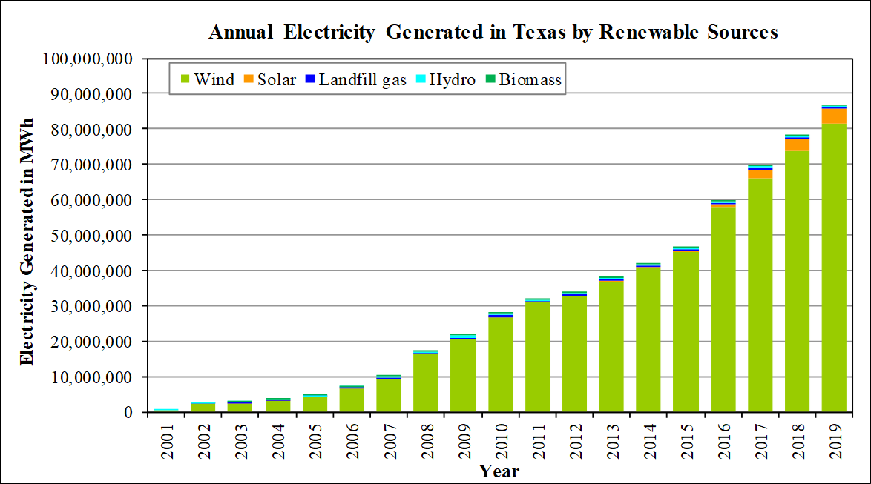
SAVINGS FROM OTHER RENEWABLES
(2001-2019)
Renewables: Biomass, Hydro, Landfill Gas, Solar, Wind
Wind energy is the largest portion
86,676 GWh (2019)
8,515 GWh
↑ 10.9%
78,161 GWh (2018)
Source: Renewable Generation Data from ERCOT-REC (Renewable Energy Credit)
Notes:
In this graph the total annual electricity generated by all renewables in Texas is shown from 2001 through 2019.
In 2019 86,676 GWh (or 86.67 million MWh) of electricity were generated, which represents a 10.9% increase (8,515 GWh) over the 78,161 GWh that were generated in 2018.
Of this total the largest amount was generated by wind (green portion of the graph), with smaller but growing amounts of electricity generated from solar, landfill gas, hydro and biomass renewable sources.
Problem with this graph is that it hides the substantial increase in the other renewables. We can see this more clearly if we look at these values only.

Slide 23
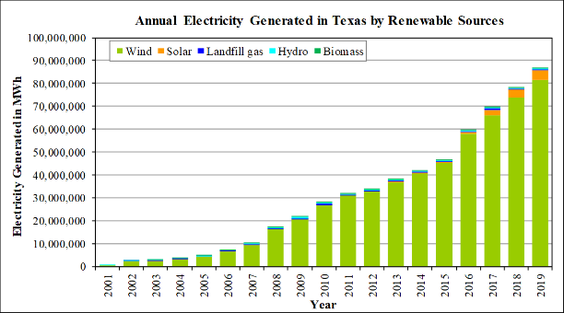
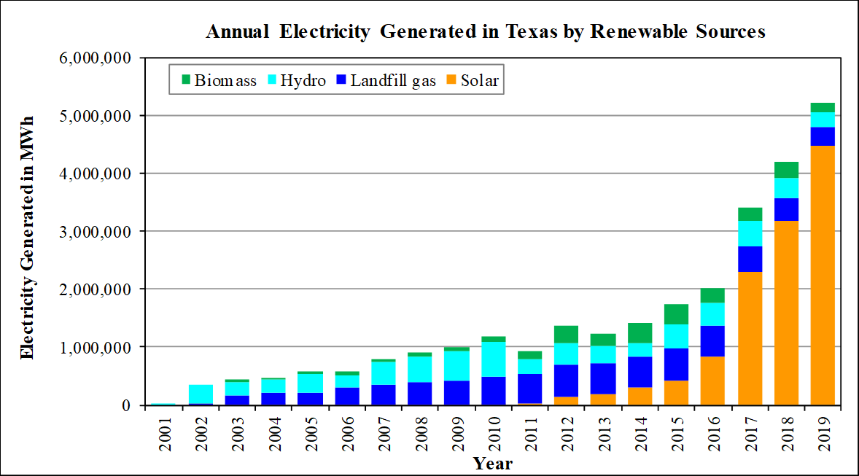
SAVINGS FROM OTHER RENEWABLES
(2001-2019)
Renewables: Biomass, Hydro, Landfill Gas, Solar, Wind
Wind energy is the largest portion
Excluding Wind
Biomass (154 GWh)
Hydro (249 GWh)
1,283 GWh
↑ 40.3%
Landfill (335 GWh)
Solar (3,183 GWh)
Solar (4,466 GWh)
Source: Renewable Generation Data from ERCOT-REC (Renewable Energy Credit)
Notes:
When we remove the wind energy generation and rescale the graph we see that the enormous increase in solar PV which was 4,466 GWh/yr in 2019, an increase of 40.3% over the 3,183 GWh/year generated in 2018.
Electricity generated by other renewables includes: landfill gas 335 GWh/year, Hydro electric (249 GWh/yr), and biomass (154 GWh/yr).

Slide 24








RENEWABLE PROJECTS IN TEXAS (2019)
Geothermal
Renewables*:
Solar PV (272 MW) - non utility scale
(29,406 projects) +4,747 projects
Solar PV (3,838 MW)- utility scale
(77 projects) +21 projects
Biomass (183 MW) (14 projects)
Hydro (557 MW) (30 projects)
Geothermal (125 MW)
(294 projects) +8 projects
Landfill Gas (58 MW) (33 projects)
Landfill Gas
Hydro
Solar PV
Biomass
Solar Pv - non utility scale
2.5 Miles Southwest of Woodville, TX
Blue Wing Solar PV Array ,San Antonio
Dam at Elephant Butte, El Paso, TX
Ground Source Heat Pump
Aspen Power plant in Lufkin, TX
https://openpv.nrel.gov
* Included renewable projects if their information/data are available
Notes:
Unfortunately, tracking the energy generated by renewables requires merging data from different sources, including utility and non-utility scale installations. In 2019 there were:
29,406 non-utility scale projects (272 MW), which included 4,747 new projects.
77 utility-scale projects (3,838 MW), which included 21 new projects.
14 biomass projects (183 MW), with no new projects. 30 Hydroelectric projects (557 MW), with no new projects.
294 geothermal projects (125 MW), with 8 new projects. 33 landfill gas projects (58 MW), no new projects.
Sources for the data were:
Non-utility scale installations there were : NREL data -> LBNL data
Solar PV – utility scale : ERCOT data Biomass : ERCOT data
Hydro : ERCOT data Landfill gas: EPA data
Geothermal : data from various websites (geothermal HVAC industry) (35,659 tons -> 125 MW), multiply the tonnage by 0.003516

Slide 25


ENERGY SAVINGS FROM PUC SB7
PUC SB7 Savings and Projections
The Public Utility Commission of Texas (PUC) Senate Bill 7 program includes their incentive and rebates programs managed by the different Utilities for Texas.
These include the Residential Energy Efficiency Programs (REEP) as well as the Commercial & Industrial Standard Offer Programs.
↑ 6.5% / year
17,615
1,148 MWh
↑ 10% (2018 to 2019)
12,680
11,532
Notes:
The electricity savings from the PUC Senate Bill 7 program includes
The Public Utility Commission of Texas (PUC) Senate Bill 7 program that includes their incentive and rebates programs managed by the different Utilities for Texas.
The Residential Energy Efficiency Programs (REEP) as well as the Commercial & Industrial Standard Offer Programs.
In 2019 12,680 MWh/year were reported, which is an increase of 1,148 MHh/year (10%) over the 2018 values reported by the PUCT
By 2024 this is expected to grow to 17,615 MWh/year (6.5% per year).

Slide 26


ENERGY SAVINGS FROM SECO
SECO Savings and Projections
The Texas State Energy Conservation Office (SECO) funds energy-efficiency programs directed towards school districts, government agencies, city and county governments, private industries and residential energy consumers.
The annual electricity savings are obtained from SECO’s energy conservation projects reported by political subdivisions
8,036
↑ 12.2% / year
792 MWh
↑ 20.6% (2018 to 2019)
4,633
3,841
Notes:
The Texas State Energy Conservation Office (SECO) reports electricity savings from their energy-efficiency programs that serve school districts, government agencies, city and county governments, private industries and residential energy consumers.
The annual electricity savings were obtained from SECO’s energy conservation projects reported by political subdivisions.
In 2019 these savings were reported to be 4,633 MWh/year, which represents a 20.6% increase over 2018.
By 2024 these savings are expected to increase to 8,036 MWh/year (12.2% per year increase).

Slide 27



INTEGRATED NOx EMISSIONS REDUCTION
Integrated Emissions Savings Across Agencies To Report Savings To TCEQ and EPA
State agencies included:
- TEES/ESL
- PUC
- SECO
- ERCOT/Renewables
- SEER 13/14
Single/Multifamily
  Total savings across agencies
  Annual emissions reductions:
- By program
- By county
- By SIP area
- By ERCOT counties
Notes:
Finally, the NOx emissions savings across Texas State Agencies are then integrated into single value, which includes:
TEES/ESL – SF, MF, Commercial building energy code compliance.
PUC SB7 – the PUC Texas Senate Bill 7 reported program savings.
SECO – electricity savings reported for their energy efficiency programs.
ERCOT/Renewables – electricity savings reported by ERCOT, NREL and LBNL
SEER 13/14 – SF and MF air conditioner replacements Statewide.
Calculated using the 2016 eGRID for the 2008 baseyear and projected through 2024
Combined electricity and NOx savings reported: by program, by county, by SIP area, by ERCOT load zones.

Slide 28


INTEGRATED NOx EMISSIONS REDUCTION
(2008 Baseyear)
2019 Integrated OSP NOx Emissions Reduction Using new 2016 eGrid
173 tons/day (2024)
↑ 8.6% / year
↑ 27.3%
114.4 tons/day (2019)
89.9 tons/day (2018)
2018 integrated OSP NOx Emissions Reduction
    ESL Code Compliance (4.93 tons/day)
    PUC SB7 programs (4.21 tons/day)
    SECO Political Sub.* (1.30 tons/day)
    Renewables (ERCOT) (78.80 tons/day)
    Residential AC Retrofits (0.63 tons/day)
    Total (2018) (89.87 tons/day)
2019 integrated OSP NOx Emissions Reduction
    ESL Code Compliance (6.13 tons/day)
    PUC SB7 programs (4.62 tons/day)
    SECO Political Sub.* (1.58 tons/day)
    Renewables (ERCOT) (99.65 tons/day)
    Residential AC Retrofits (2.43 tons/day)
    Total (2019) (114.42 tons/day)
2024 integrated OSP NOx emissions reduction
    ESL Code Compliance (12.77 tons/day)
    PUC SB7 programs (6.38 tons/day)
    SECO Political Sub. * (2.81 tons/day)
    Renewables (ERCOT) (149.85 tons/day)
    Residential AC Retrofits (1.88 tons/day)
    Total (2024) (173.69 tons/day)
Notes:
This graph shows the Statewide, integrated NOx Emissions Reduction (2008 baseyear).
In 2019 the NOx emissions were 114 tons/OSD, which is an increase of 27.3% over 2018.
By 2024 the NOx emissions are expected to grow to 173 tons/OSD (8.6% increase per year).
In 2019 the largest NOx emissions were from renewables (99.6 tons/OSD), followed by energy code-compliance (6.13 tons/OSD), PUC SB7 (4.62 tons/OSD), SEER 13/14 retrofits (2.43 tons/day), and SECO energy efficiency programs (1.58 tons/OSD).

Slide 29





REPORTS AND PAPERS: TERP
Reports: 2002 through 2019
Recent Reports:
Statewide 2019 Air Emission Calculations from Wind and Other Renewables (Vol I and Vol II)
TCEQ 2019 Annual Preliminary Report: Integrated NOx Emissions Savings from EE/RE Programs Statewide
TCEQ 2019 Annual Report Volume I: Technical Report
TCEQ 2019 Annual Report Volume II: Technical Appendix
Notes:
The technical details for the NOx emissions reductions are presented in the ESL’s TERP report to the TCEQ (5 volumes):
Statewide 2019 Air Emission Calculations from Wind and Other Renewables (Vol I and Vol II)
TCEQ 2019 Annual Preliminary Report: Integrated NOx Emissions Savings from EE/RE Programs Statewide
TCEQ 2019 Annual Report Volume I: Technical Report
TCEQ 2019 Annual Report Volume II: Technical Appendix

Slide 30





REPORTS AND PAPERS: TERP
Publications: 2019
Dissertation 2019:
Azizkhani, M. “Investigating the Level of Application/Education of Passive/Natural Systems in the Design of Sustainable Buildings in the US", PhD., Department of Architecture, April 2019.
Ahn, J, “Origins of Whole-Building Energy Simulation Programs Used for High Performance Commercial Buildings: Contributions of the MATEUS, SHEP, TACS, CP-26, CP-33 and RESPTK Programs”, MS., Department of Architecture, August 2019.
Papers 2019:
Farias, F., Kota, S., Jeong, W., Kim, J., Alcocer, J, Haberl, J.S., Clayton, M.J., Yan, W., 2019. “Development of a Reference Building Information Model (BIM) for Thermal Model Compliance Testing - Part II: Test Cases and Analysis (RP-1468)", ASHRAE Transactions.
Wang, L., Sakurai, Y., Bowman, S.J., Claridge, D.E., 2018. "Commissioning an Existing Heat Recovery Chiller System at a Large District Plant", ASHRAE Transaction.
Shin, M., Haberl, J.S., 2019. “Thermal Zoning for Building HVAC Design and Energy Simulation: A Literature Review", Energy and Buildings, Vol 203.
Shajahan, A, Culp, C.H., Williamson, B., 2019. “Effects of Indoor Environmental Parameters Related to Building Heating, Ventilation, and Air Conditioning Systems on Patients’ Medical Outcomes: A Review of Scientific Research on Hospital Buildings”, Indoor Air, Vol 29, Issue 2, pp.161-176.
Notes:
In addition to the TERP reports, other related publications include:
Azizkhani, M. “Investigating the Level of Application/Education of Passive/Natural Systems in the Design of Sustainable Buildings in the US", PhD., Department of Architecture, April 2019.
Ahn, J, “Origins of Whole-Building Energy Simulation Programs Used for High Performance Commercial Buildings: Contributions of the MATEUS, SHEP, TACS, CP-26, CP-33 and RESPTK Programs”, MS., Department of Architecture, August 2019.
Farias, F., Kota, S., Jeong, W., Kim, J., Alcocer, J, Haberl, J.S., Clayton, M.J., Yan, W., 2019. “Development of a Reference Building Information Model (BIM) for Thermal Model Compliance Testing - Part II: Test Cases and Analysis (RP-1468)", ASHRAE Transactions.
Wang, L., Sakurai, Y., Bowman, S.J., Claridge, D.E., 2018. "Commissioning an Existing Heat Recovery Chiller System at a Large District Plant", ASHRAE Transaction.
Shin, M., Haberl, J.S., 2019. “Thermal Zoning for Building HVAC Design and Energy Simulation: A Literature Review", Energy and Buildings, Vol 203.
Shajahan, A, Culp, C.H., Williamson, B., 2019. “Effects of Indoor Environmental Parameters Related to Building HVAC Systems on Patients’ Medical Outcomes: A Review of Scientific Research on Hospital Buildings”, Indoor Air, Vol 29, No.2, pp.161-176.

Slide 31

ESL Contact Information
Contact Information:
Jeff Haberl: jhaberl@tamu.edu
Bahman Yazdani: byazdani@tamu.edu
http://esl.tamu.edu/terp
Contact Information:
Jeff Haberl: jhaberl@tamu.edu
Juan-Carlos Baltazar: jbaltazar@tamu.edu
Bahman Yazdani: byazdani@tamu.edu
http://esl.tamu.edu/terp
Notes:
Contact Information:
Jeff Haberl: jhaberl@tamu.edu
Juan-Carlos Baltazar: jbaltazar@tamu.edu
Bahman Yazdani: byazdani@tamu.edu
http://esl.tamu.edu/terp

