Slide 1
Future Directions for TERP
12 November 2019
Texas Energy Summit
Austin, Texas

Slide 2
Think Ahead – Avoid Stranded Cost Risks
“As the world transitions to a low-carbon economy, as much as $10 trillion of fossil fuel assets could become ‘stranded’ as regulations and [cheaper] clean energy sources make those investments economically unviable.” – Moody’s, quoted in Financial Times, July 4, 2019
Analogy to Power Sector:
  Coal => Natural Gas => Renewables (Wind & Solar)
  Mobile Sources: Diesel => CNG => Electricity

Slide 3
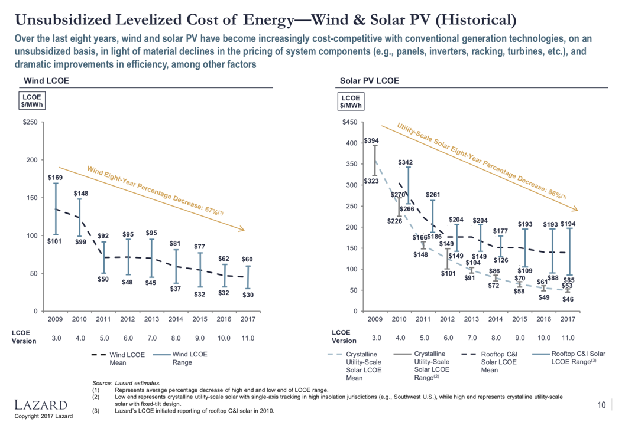
Clean Electricity is Rapidly Getting Cheaper…
Wind & Solar are now often the least-cost energy option
Notes:
Source: Lazard, LCOE v11, 2017.
And now is the cheapest source of kwh when available.

Slide 4
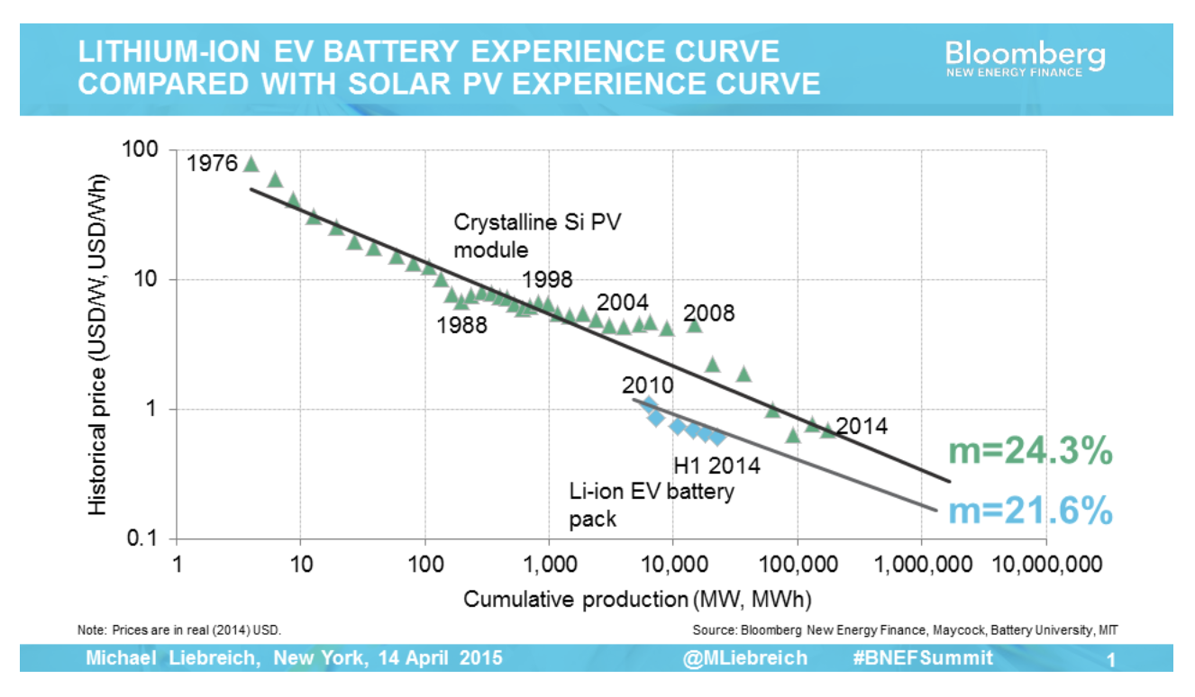
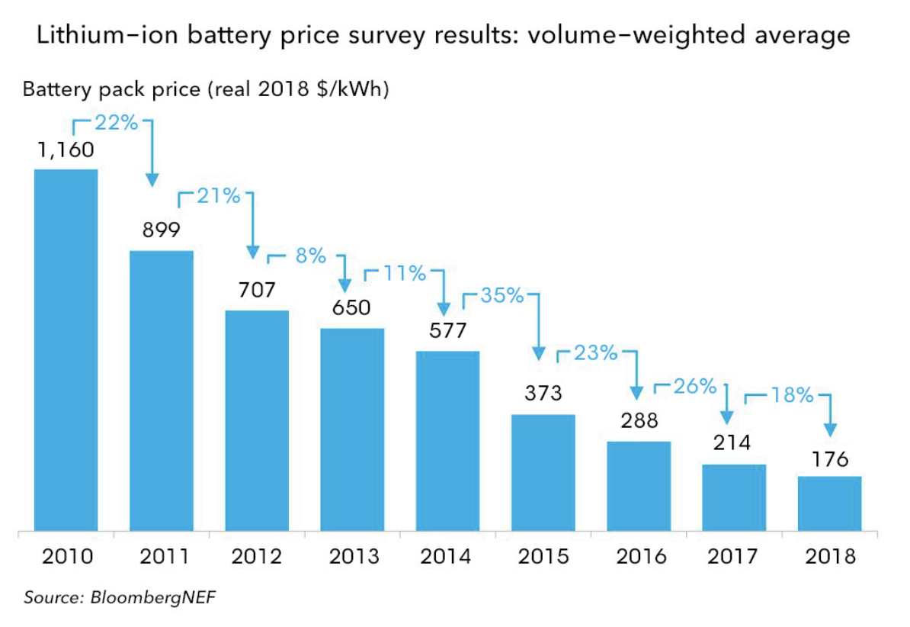
And So Are Batteries…
Notes:
Source (Experience Curve): https://rameznaam.com/2015/10/14/how-cheap-can-energy-storage-get/
Source (Price Survey Results): https://about.bnef.com/blog/behind-scenes-take-lithium-ion-battery-prices/

Slide 5

The Grid is Getting Cleaner…

Slide 6
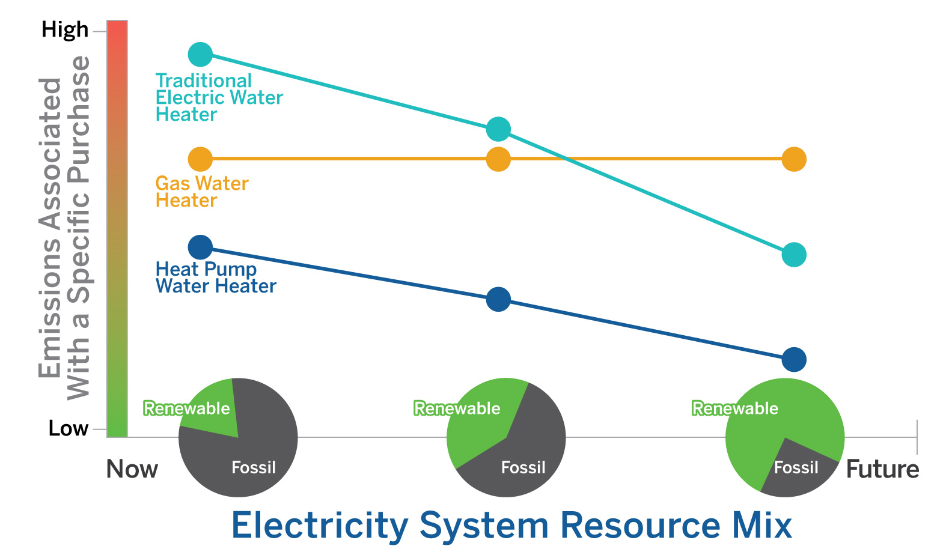
Consider Cost & Emissions Over Time…
Conclusion:
Trends favor EVs as cheaper and cleaner
Notes:
Despite using more kWhs of electricity,
if electrification is beneficial,
then consumers will use less energy overall,
thereby producing fewer pounds of pollution per per gallon of hot water produced or
per vehicle mile traveled.
This is a significant step beyond energy efficiency business-as-usual and
the way energy savings have been separately accounted for,
in other words, as kWh of electricity, therms of gas, and gallons of petroleum products.
Beneficial electrification adopts a total-system efficiency viewpoint and seeks to recognize the reduction in the use of primary energy.
Let’s look at an illustration of emissions efficiency using (Button) the investment in a water heater as an example.

Slide 7
Focus on Medium- & Heavy-Duty Vehicles
TCEQ 2008 Attainment Demonstration Ozone SIP Revision Modeling:
  DFW (2013): Non-LDV = 17% VMT, 63% Mobile Source NOx
  HGB (2013): Non-LDV = 14% VMT, 57% Mobile Source NOx
  Average = 15.5% VMT, 60% Mobile Source NOx
Also serves economic (jobs) and equity (low- & middle-income) well
Conclusion:
  Electrify, don’t retrofit
  Focus on medium- & heavy-duty vehicles

Slide 8


Slide 10
Xcel Energy, All-Source Bids, December 2017
$.037/kWh
$37/MWh
$.030/kWh
$.029/kWh
$30/MWh
$30/MWh
$.025/kWh
$25/MWh
$.018/kWh
$18/MWh
Fuels
Technologies
Xcel Energy, All-Source Bids, December 2017. Existing Plant Average Fuel and O&M from USE IA, Table 8.4, Electric Power Annual 2016
Notes:
Let’s put these side by side.
Wind coming in at less than the fuel costs alone for coal and gas. Solar for less than the operating costs of coal or gas.
This means that a utility that has plenty of capacity should still consider buying wind in order to reduce fuel costs and customer bills.
Even if it keeps the old plants available for times when the wind is not blowing, they will have lower total costs.
===
Xcel Energy, in Colorado, reported in December 2017 the results of its all-sources competitive bidding. This was not a one-off result. 238 projects, totaling 58,283 megawatts. Capacity at attractive prices. Energy at attractive prices.
Think about this. This is really cheap.
How cheap? Let’s compare this to the OPERATING COSTS of existing traditional power plants.
USEIA annually publishes the variable operating costs of different type sof power plants. For 2016, the last year published, Coal cost an average of $37/MWh just for fuel and operating costs, ignoring the capital investment in existing units. Gas was a little lower, at $30/MWh, and nuclear cheaper still at $25.
I will note, however that these are averages. Single-station power plants, whether they are a single 250 MW gas combined-cycle unit, or a single 1100 MW nuclear plant, have significantly higher costs; in 2016, the Columbia Generating Station, a single-station nuclear plant in Washington State, had total O&M costs of over $38/MWh.
So, what does this mean? Wind coming in at less than the fuel costs alone for coal and gas. Solar for less than the operating costs of coal or gas.
This means that even a utility that has plenty of capacity should still consider buying wind in order to reduce fuel costs and customer bills.

