Slide 1


Energy Efficiency and Renewable Energy Impacts on NOx Emission Reductions in Texas
  Jeff Haberl, Ph.D.
  Bahman Yazdani, P.E.
  Juan-Carlos Baltazar, Ph.D., P.E.
TEXAS ENERGY
SUMMIT
Houston, Texas
September 24-26, 2018
Notes:
Howdy! It my pleasure to give you the “state of the state” update for 2018…

Slide 2
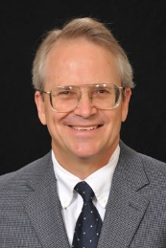
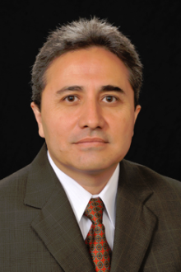






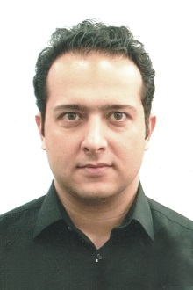



ACKNOWLEDGEMENTS
Faculty/Staff: Jeff Haberl, Bahman Yazdani, Juan-Carlos Baltazar, Gali Zilbershtein,
Shirley Ellis, Patrick Parker, Angela Rowell
Students: Minjae Shin, Farshad Kheiri, Qinbo Li, Sungkyun Jung, Chul Kim
              TCEQ: Vince Meiller, Bob Gifford
              PUCT: Katie Rich, Therese Harris
              SECO: Dub Taylor, Stephen Ross
              ERCOT: Paul Wattles, Connor Anderson
Notes:
The TERP group at the Energy Systems Lab, which is part of the TEES consists of faculty, staff and students.
+ CoPIs for the TERP program are Bahman Yazdani and Prof. Juan-Carlos Baltazar.
+ TERP staff include: Dr. Gali Zilbershtein, Shirley Ellis, Patrick Parker, and Angela Rowell
+ TERP students include Dr. Minjae Shin (now at Univ. of Alabama), Farshad Kheiri, Qinbo Li, Sungkyun Jung and Chul
+ The ESL also would like acknowledge significant contributions by TCEQ (Vince Meiller, Bob Gifford),
PUCT (Katie Rich, Therese Harris), SECO (Dub Taylor, Stephen Ross), ERCOT (Paul Wattles, Conner Anderson).

Slide 3

LEGISLATION
Legislation to Reduce Energy/Emissions 2001 to Present
Senate Bill 5 (77th Legislature, 2001)
Ch. 386. Texas Emissions Reduction Plan
  Sec. 386.205. Evaluation Of State Energy Efficiency Programs (with PUC)
Ch. 388. Texas Building Energy Performance Standards
  Sec. 388.003. Adoption Of Building Energy Efficiency Performance Standards.
  Sec. 388.004. Enforcement Of Energy Standards Outside Of Municipality.
  Sec. 388.007. Distribution Of Information And Technical Assistance.
  Sec. 388.008. Development Of Home Energy Ratings.
TERP Amended (78th Legislature, 2003)
Ch. 388. Texas Building Energy Performance Standards
  (HB 1365) Sec. 388.004. Enforcement Of Energy Standards Outside Of Municipality.
  (HB 1365) Sec. 388.009. Energy-Efficient Building Program.
Ch. 388. Texas Building Energy Performance Standards
  (HB 3235) Sec. 388.009. Certification of Municipal Inspectors.
TERP Amended (79th Legislature, 2005)
Ch. 382. Health and Safety Code
  (HB 2129) Sec. 386.056 Development of Creditable Statewide emissions from wind and other renewables.
  (HB 965) Sec. 382.0275 Commission Action Relating to Water Heaters
TERP Amended (80th Legislature, 2007)
Ch. 382. Health and Safety Code
(HB 3693) Sec. 388.003 added subsection (b-1), (b-2), (b-3) that allows SECO to adopt new editions of the IECC based on written recommendations from the Laboratory.
(HB 3693) Sec. 388.008 Development of Standardized report formats for newly constructed residences.
Ch. 386.252 Health and and Safety Code
(SB 12) Section 388.03 added subsection (b-1), (b-2) allows SECO to adopt new editions of the IECC based on written recommendations from the Laboratory.
TERP Amended (81st Legislature, 2009)
Ch. 382. Health and Safety Code
  (HB 1796) Section 23 amends Sec. 386.252 (a) and (b) extends date of TERP to 2019 and requires Commission to contract with Laboratory for creditable EE/RE emissions reductions.
TERP Amended (82nd Legislature, 2011)
Ch. 477.004 Health and Safety Code
  HB 51 Section 2, b-2, establishes advisory committee, which including the Laboratory
  Section 3 & 4 amends review of municipal’s amendments.
Ch. 388.003e & 388.007c,d Health and Safety Code
  HB 51 Section 3 & 4 amends review of municipal’s amendments.
Ch. 388.006 Health and Safety Code
  SB 898 Section 2, requires the Laboratory to calculate energy savings and emissions reductions for political subdivisions reporting to SECO.
Ch. 39.9051 Utilities Code
  SB 924 Section 1g,h and Section 2c,d requires the Laboratory to calculate energy savings and emissions reductions for political subdivisions reporting to SECO.
  NO new amendments were passed (83rd Legislature, 2013)
  TERP Amended (84th Legislature, 2015)
  Section 388.003, Health and Safety Code
  HB 1736 Section 1 Establishes the 2015 energy codes as the TBEPS effective Sept 1, 2016. The state may adopt new codes no sooner than every 6 years. The section also adds Energy Rating Index as a voluntary compliance alternative.
NO new amendments were passed (85th Legislature, 2017)
Notes:
The ESL’s legislative responsibilities started in 2001 with the 77th Legislature through Senate Bill 5
This was amended in 2003 (78th Legislature) with new duties through HB 1365
Amended again in 2005 (79th Legislature) with more duties, including: creditable NOx emissions calculations
Amended in 2007 (80th Legislature) additional duties include: Recommendation for new IECC versions to SECO
Amended in 2009 (81st Legislature) extended dates of TERP to 2019, including direct contract for NOx emissions reductions from TCEQ
Amended in 2011 (82nd Legislature) extended duties with NOx calculations for municipalities, political subdivisions, etc.
No new amendments in 2013.
Amended in 2015 (84th Legislature): HB 1736 Section 1 Establishes the 2015 energy codes as the TBEPS effective.
No new amendments in 2017.

Slide 4
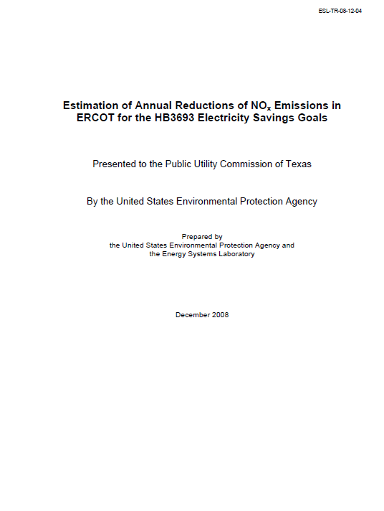
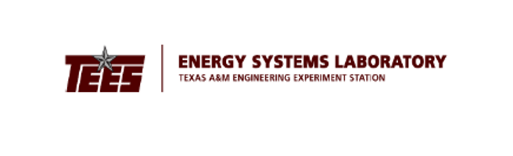
EPA CRITERIA FOR SIP CREDITS (2004)
Quantifiable: The emission reductions generated by measures to reduce emissions must be quantifiable and include procedures to evaluate and verify over time the level of emission reductions actually achieved.
Surplus: Emission reductions are surplus as long as they are not otherwise relied on to meet air quality attainment requirements in air quality programs related to your SIP.
Enforceability: Measures that reduce emissions from electricity generation may be: (1) Enforceable directly against a source; (2) Enforceable against another party responsible for the energy efficiency or renewable energy activity; or (3) Included under our voluntary measures policy.
Record Keeping: The measure should be permanent throughout the term for which the credit is granted unless it is replaced by another measure or the State demonstrates in a SIP revision that the emission reductions from the measure are no longer needed to meet applicable requirements.
Notes:
The ESL follows the published EPA Criteria for State Implementation Plan (SIP) Credits (2004)
Quantifiable: The emission reductions generated by measures to reduce emissions must be quantifiable and include procedures to evaluate and verify over time the level of emission reductions actually achieved.
Surplus: Emission reductions are surplus as long as they are not otherwise relied on to meet air quality attainment requirements in air quality programs related to your SIP.
Enforceability: Measures that reduce emissions from electricity generation may be: (1) Enforceable directly against a source; (2) Enforceable against another party responsible for the energy efficiency or renewable energy activity; or (3) Included under our voluntary measures policy.
Record Keeping: The measure should be permanent throughout the term for which the credit is granted unless it is replaced by another measure or the State demonstrates in a SIP revision that the emission reductions from the measure are no longer needed to meet applicable requirements.

Slide 5

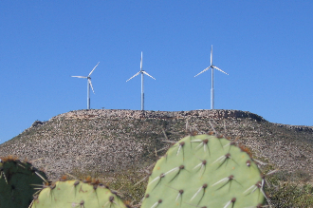


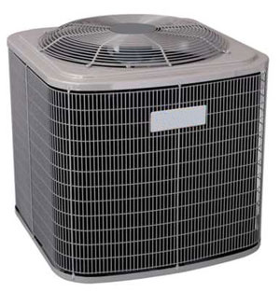
ENERGY SAVINGS & NOx EMISSION REDUCTION
ESL Calculates & Reports NOx Emissions Reductions for:
1. Code-Compliant Construction: Energy savings from new construction
ESL Single-family construction
ESL Multi-family construction
ESL Commercial construction
2. Green Power Production: Wind and other renewables
3. PUC SB7: Energy efficiency programs implemented by electric utilities under the Public Utility Regulatory Act §39.905
4. SECO: Energy-efficiency programs towards school districts, government agencies, city and county governments, private industries and residential energy consumers
5. A/C Retrofits: Installation of SEER 13/14 replacement air conditioners in existing residences
Notes:
1. Code-Compliant Construction: Energy savings from new constructions
ESL Single-family construction
ESL Multi-family construction
ESL Commercial construction
2. Green Power Production: Wind and other renewables
3. PUC SB7: Energy efficiency programs implemented by electric utilities under the Public Utility Regulatory Act §39.905
4. SECO: Energy-efficiency programs towards school districts, government agencies, city and county governments, private industries and residential energy consumers
5. A/C Retrofits: Installation of SEER 13/14 replacement air conditioners in existing residences

Slide 6
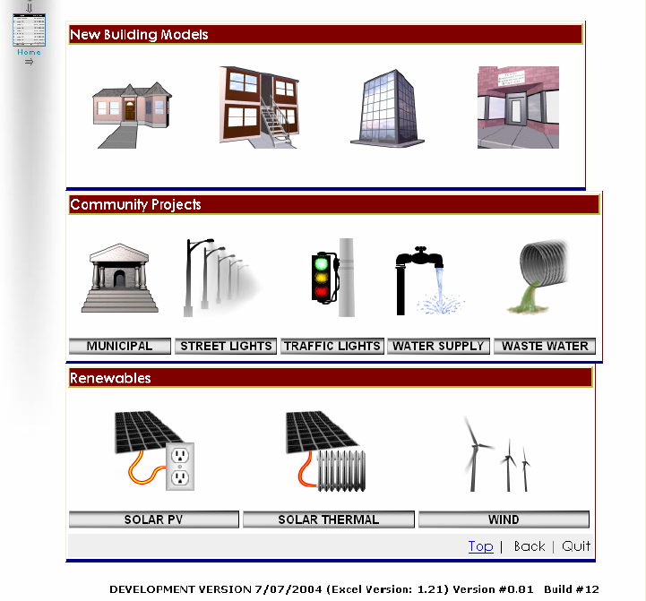
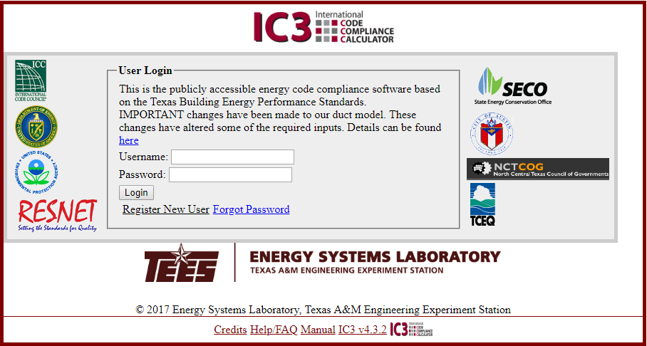
Evolution of the Calculator: 2004 to Present
2004 Version (eCalc)
Originally part of the web page for EE/RE.
Included: New buildings, Community projects, renewables
Demonstrated feasibility of web-based calculator
2007 Version (IC3)
Developed in 2007 for (2001 IECC)
Certified code compliance calculator
Issued certificates (2001 & 2009 IECC)
Results compiled into registry
Registry used to track compliance
Formatted for use by PC
Current Version (IC3)
Originally based on 2009/2012 IECC
Currenty using 2015 IECC
Certified code compliance
Reformatted for use by smart phones,etc.
Issues certificates (2015 IECC)

Slide 7

Current 2018 Version
Login Screen
Notes:
One of the Tools the ESL has developed to assist homeowners, builders and code officials is the International Code Compliance Calculator (IC3) – a free IECC 2015 code-compliance calculator that performs an annual, hourly simulation of the proposed house.
+ IC3 provides: single-family/multi-family code compliance certificates for homeowners that certifies that their home meets
+ IC3 provides the ESL with a valuable database of code-compliant houses around the state.
+ This is the login screen for IC3.
+ Users are allowed to create a username and password so they can enter and save information about projects.
+ Each project has a serial number that provides a unique record.

Slide 8

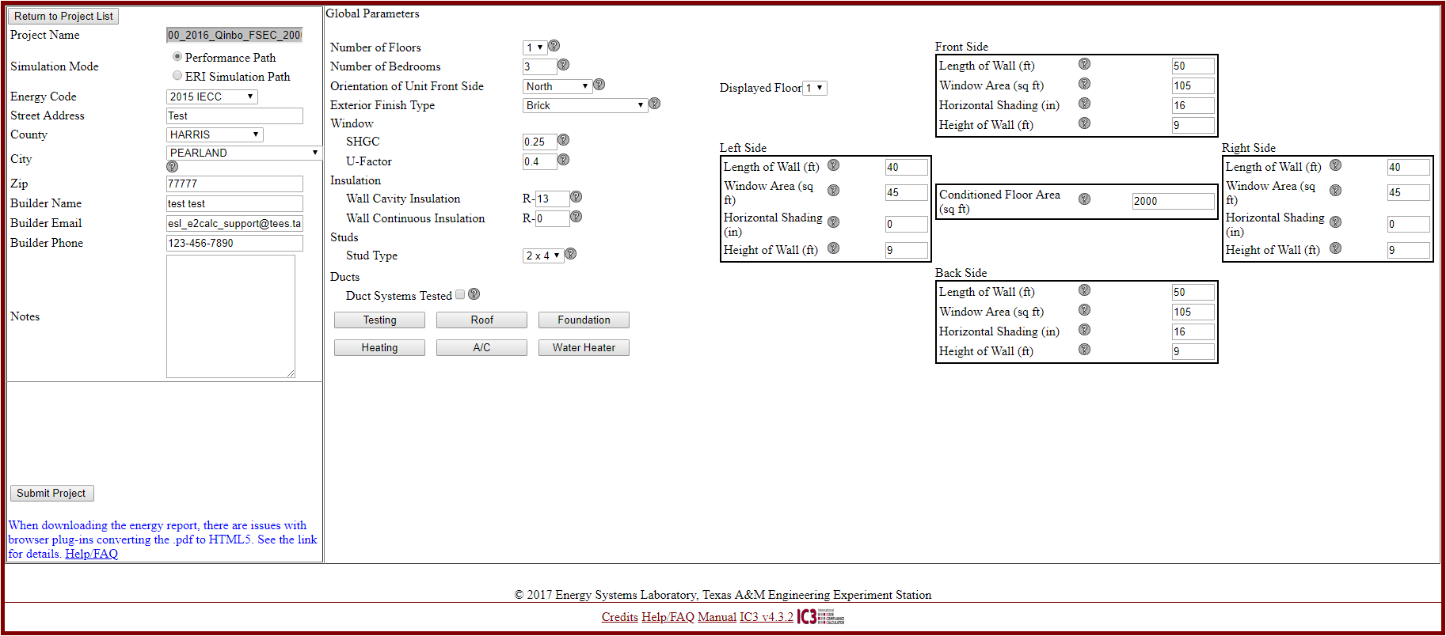
Current 2018 Version
Main Page
Notes:
This is the main page:
+ IC3 input screens have been redesigned for use on computers, tablets, smart phones, etc.
+ General project information, name address, etc.
+ Global parameters about the house, for example, # of floors, # of bedrooms, SHGC, U-factor, equivalent house dimensions, duct system testing, etc.

Slide 9
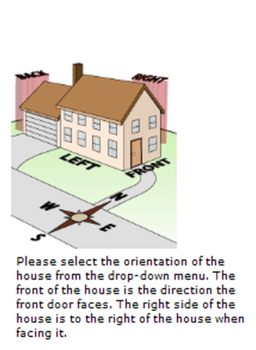
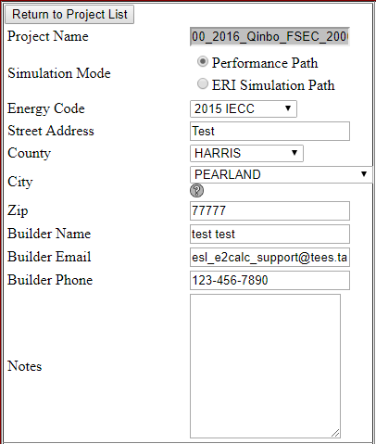
Current 2018 Version
Energy Code/Site Address/Project Details
Notes:
Here’s a detail about the General Project information, energy code, address, name, address, builder’s name.

Slide 10
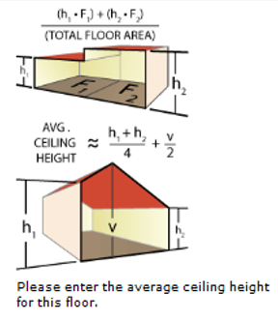
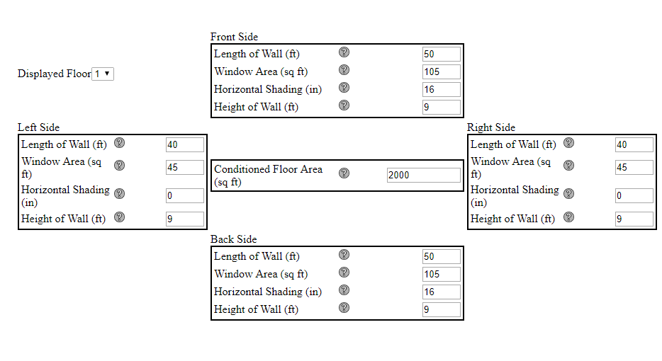
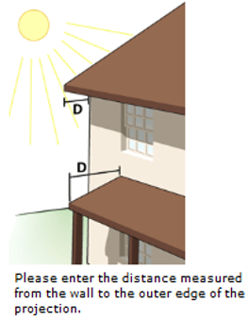
Current 2018 Version
Floors/Bedrooms/Foundation
Notes:
Here’s a detail of the input form for the house dimensions, floor area, shading, etc.

Slide 11
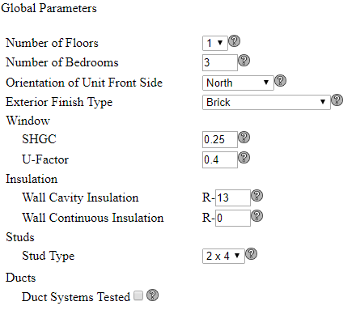
Current 2018 Version
Global Parameters
Notes:
Example of the input screen for the Global Parameters: # of floors, # bedrooms, orientation, SHGC, U-value, etc.

Slide 12
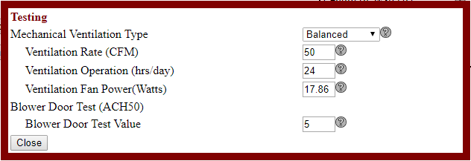
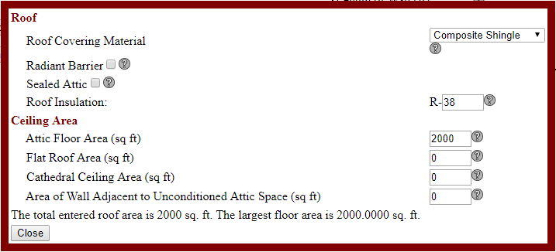
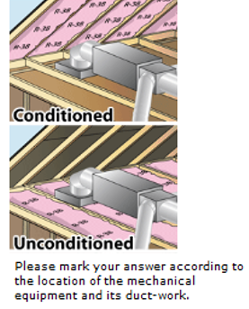
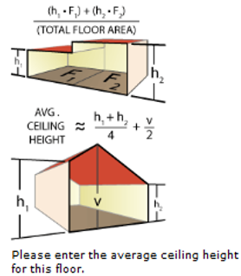
Current 2018 Version
Testing
Roof
Notes:
Examples of the input screens when the user enters duct testing information, as well as information about the roof, ceiling, etc.

Slide 13
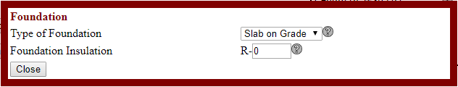
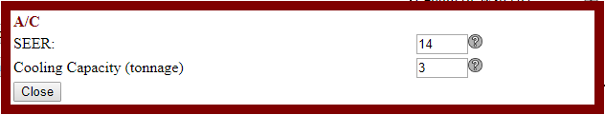
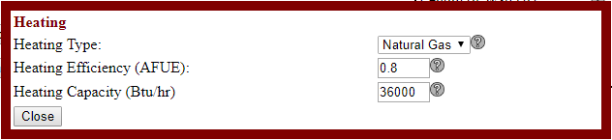
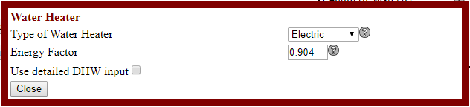
Current 2018 Version
Foundation
A/C
Heating
Water Heater
Notes:
Inputs for the information describing the Foundation insulation (if any), A/C efficiency, Heating and Water Heating efficiency.

Slide 14
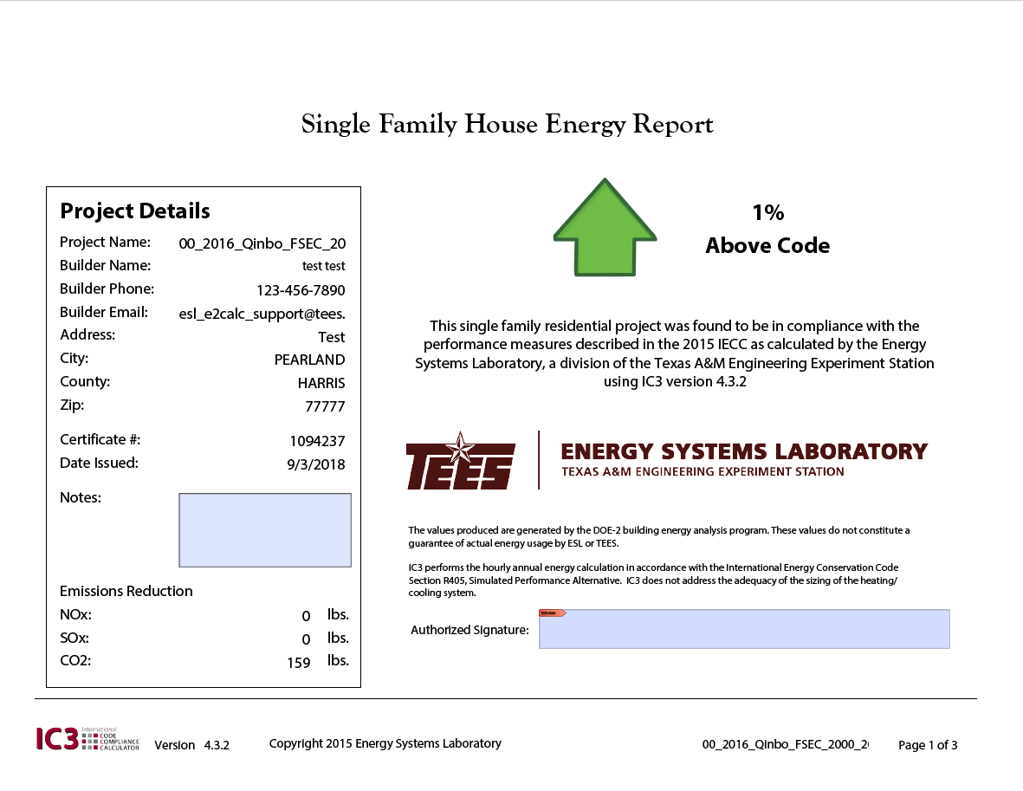
Current 2018 Version
Certificate
Notes:
When the user enters all the information IC3 calculates whether or not the residence meets or exceeds code compliance using the Simulated Performance Alternative Path…
+ in the example this house performs 1% above the performance of a house with similar features that meets the IECC code.
+ IC3 also shows the Nox, SOx and CO2 emissions reductions for the house versus a house that meets code.

Slide 15
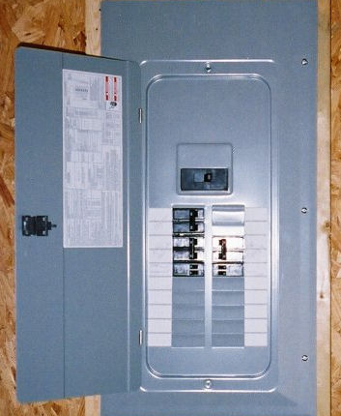
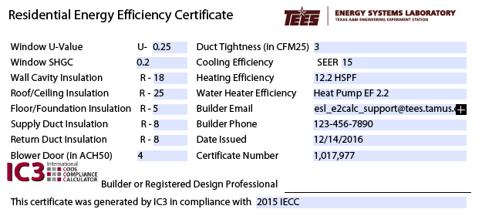
Current 2018 Version
IC3 Prints Certificate for Posting on Electrical Panel
Records Certificate in IC3 Registry
Prints Certificate for Electrical Panel
Notes:
The user can then print the IC3 certificate and attach to the electrical panel for the house to serve as a permanent record that this house was built incompliance with the IECC
+ The certificate includes the certificate # in case the current or future homeowner wants to learn more about their house.
+ The ESL maintains a database of all houses entered into IC3.

Slide 16




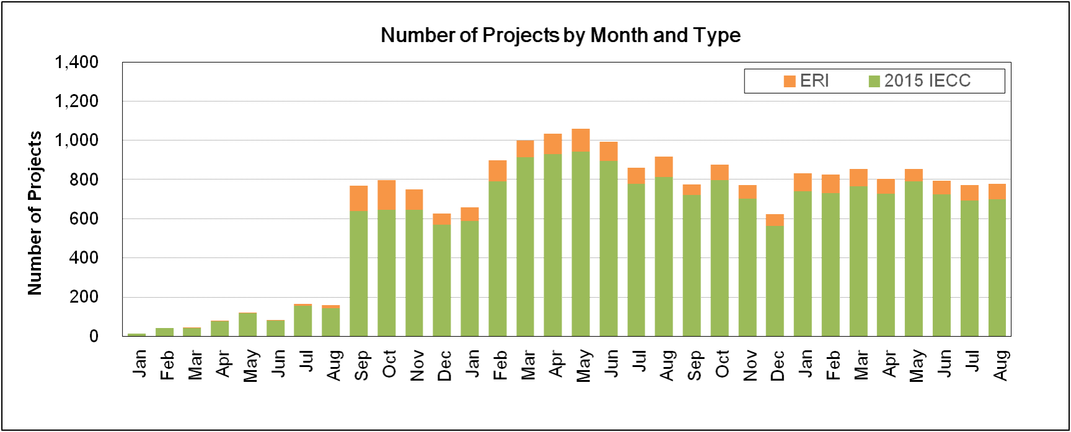



STATEWIDE SAVINGS FROM CODE COMPLIANCE
(2000 – 2017)
How much electricity has been saved from residential code compliance for all single-family housing 2000-2018?
IC3 Projects/Certificates
2016
2017
2018
Notes:
The ESL has had to update and modify IC3 for use by the different versions of the IECC as they have been released and adopted for use by the State of Texas.
+ Here’s a look at the certificates from IC3 for 2016 through 2018.
+ Use of the 2015 IECC actually began as soon as it was adopted in September 2016.
+ Use of the new Energy Rating Index “ERI index” is also shown, lagging behind the 2015 performance path.
2016 Total
ERI: 480
2015 IECC: 3,183
2017 Total
ERI: 1,030
2015 IECC: 9,450
2018 Total
ERI: 658
2015 IECC: 6,316

Slide 17
STATEWIDE SAVINGS FROM CODE COMPLIANCE
2000 – 2017 (ESTIMATED)
Increased Costs (2002 to 2017)
Costs: $ 1,825 million
Savings (2002 to 2017)
Electricity (Envelope): $2,151 million (+10.6%)
Electricity (HVAC Systems): $1,902 million (+21.7%)
Demand: $2,718 million (+14.3%)
Total: $6,771 million (+15.1%)
Savings (2002 to 2016)
Electricity (Envelope): $1,945 million
Electricity (HVAC Systems): $1,563 million
Demand: $2,377 million
Total: $5,885 million
NOx Emissions Reduction
66.69 tons NOx / year
Emissions Reduction in 2017
(Equivalent to about 50,700 cars)
Total: $6,771 million
Demand: $2,718 million
Millions $
Electricity (HVAC Systems): $1,902 million
Cost: $1,825 million
Electricity (Envelope): $2,151 million
Notes:
Single Family
NOx emissions reduction (baseyear 2008 for the nox emission reduction)
Number of cars are calculated by multiply 760

Slide 18
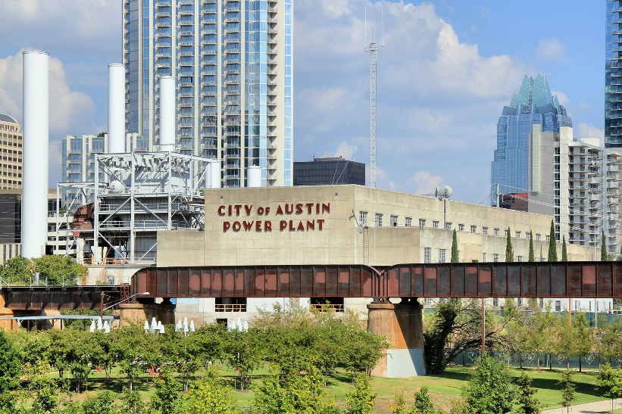
STATEWIDE WATER SAVINGS AT POWER PLANTS
2002~2017
Electricity/Water Savings from SF (Code Compliance)
Seaholm Power Plant, Austin
Conversion Factors: 430 gal/MWh
325,851 gal/acre-ft

Slide 19
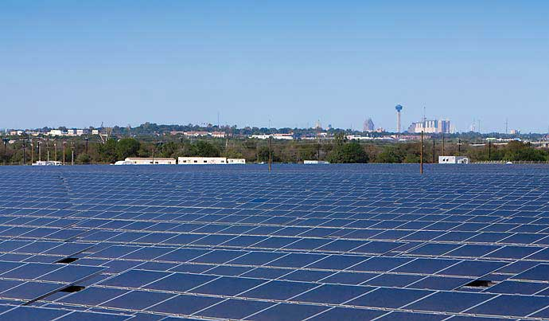
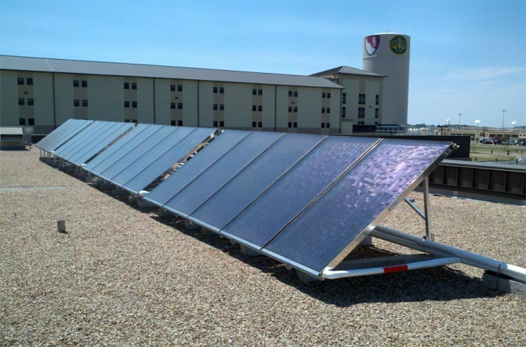
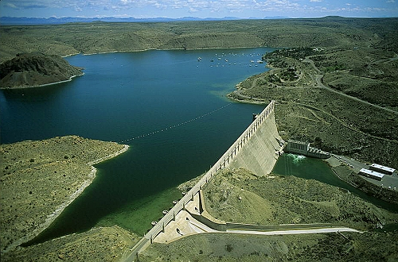
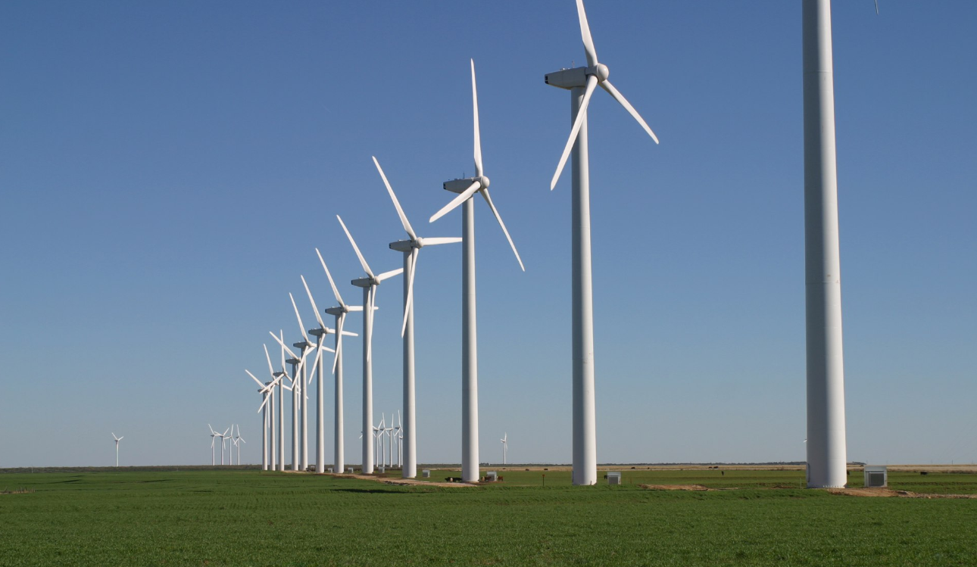
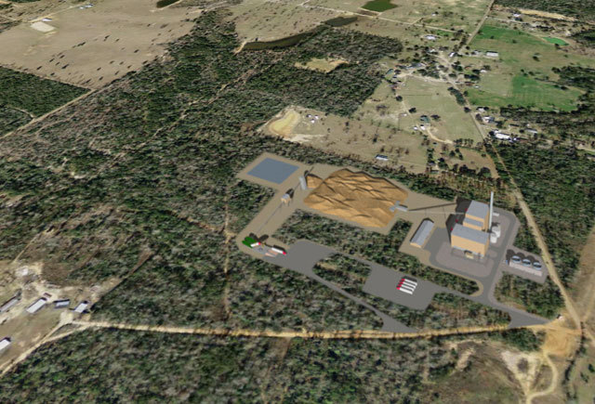
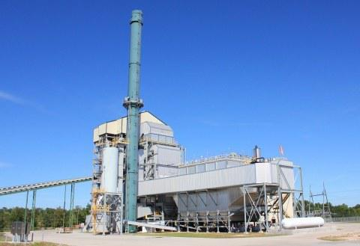
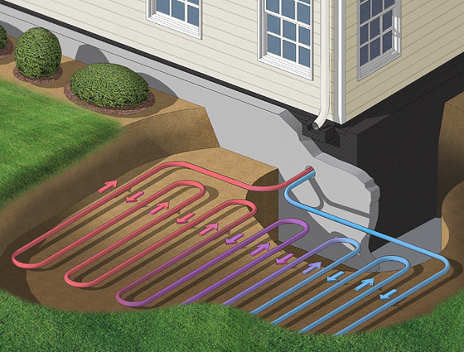
SAVINGS FROM RENEWABLES
Blue Wing Solar PV Array ,San Antonio
Sunmaxx Solar Thermal, Fort Hood, TX
Dam at Elephant Butte, El Paso, TX
Wind
Brazos Wind Ranch, TX.
Solar PV
Solar Thermal
Hydro
2.5 Miles Southwest of Woodville, TX
Aspen Power plant in Lufkin, TX
Ground Source Heat Pump
Biomass
Landfill Gas
Geothermal

Slide 20
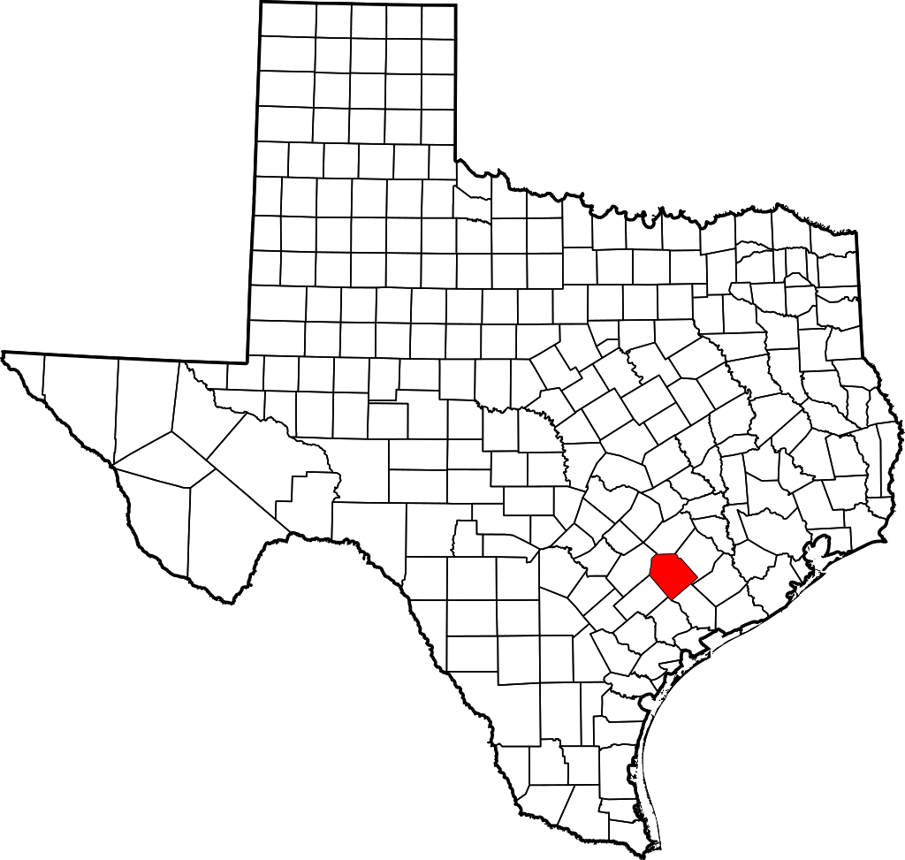
WIND PROJECTS IN TEXAS (2017)
Completed, Announced, and Retired Wind Projects in Texas, as of Dec. 2017
Hansford
Ochiltree
ERCOT: Electric Reliability Council of Texas
Moore
Hutchinson
WSCC: Western Systems Coordinating Council
NUMBER OF WIND PROJECTS COMPLETED
Oldham
Carson
Gray
ERCOT
SPP
WECC
Deaf Smith
Armstrong
Donley
SPP: Southwest Power Pool
1 - 2
1 - 2
1 - 2
Parmer
Castro
Briscoe
3 - 4
3 - 4
3 - 4
Floyd
Wilbarger
5 <
5 <
5 <
Clay
Crosby
Dickens
Knox
Archer
Cooke
Lynn
Kent
Haskell
Young
Jack
Borden
Scurry
Shackelford
Martin
Howard
Mitchell
Nolan
Taylor
Erath
El Paso
Ector
Glasscock
Sterling
Comanche
Culberson
Upton
Tom
Green
Concho
Mills
Pecos
Val Verde
Kinney
ERCOT Power Grid and
Wind Farms in Texas
Webb
San Patricio
Nueces
Zapata
Jim Hogg
Kenedy
Starr
Hidalgo
Willacy
Cameron
Notes:
The number of "Completed Wind Projects"

Slide 21
WIND PROJECTS IN TEXAS (2017)
Completed, Announced, and Retired Wind Projects in Texas, as of Dec. 2017
Sherman
Hansford
Ochiltree
ERCOT: Electric Reliability Council of Texas
Moore
WSCC: Western Systems Coordinating Council
NUMBER OF WIND PROJECTS ANNOUNCED
Oldham
Carson
ERCOT
SPP
WECC
MISO
Deaf Smith
Randall
Armstrong
SPP: Southwest Power Pool
1 - 2
1 - 2
1 - 2
1 - 2
Parmer
Castro
Swisher
Briscoe
3 - 4
3 - 4
3 - 4
3 - 4
Bailey
Hale
Floyd
Hardeman
Wilbarger
5 <
5 <
5 <
5 <
Crosby
Cochran
Baylor
Lynn
Scurry
Fisher
Mitchell
Nolan
Callahan
Erath
Glasscock
Hamilton
Culberson
(2) Retired
Regan
Concho
Mills
Jeff Davis
Schleicher
McCulloch
(1) Retired
Crockett
Brewster
Brazoria
Matagorda
ERCOT Power Grid and
Wind Farms in Texas
Webb
San Patricio
Nueces
Kenedy
Starr
Willacy
Notes:
The number of "Announced and Retired Wind Projects"

Slide 22
WIND PROJECTS IN TEXAS (2017)
Total Capacity 22,519 MW
ERCOT Capacity 20,885 MW
Total Wind Power 62,189 GWh
4,784
on Dec. 2017
Notes:
The Electric Reliability Council of Texas (ERCOT), the electric grid that serves most of Texas, set back-to-back hourly system-wide peak demand records on Wednesday, July 18, 2018, and for the first time exceeded 72,000 MW of electricity demand.

Slide 23
WIND FARMS CAPACITY/PRODUCTION
2008 Annual Modeled vs. 2017 Annual Measured
8% Increase
2008 Calculated from 2017 Measured Annual Power Production

Slide 24
WIND FARMS CAPACITY/PRODUCTION
2008 OSP Modeled vs. 2017 OSP Measured
0.7% Increase
2008 Calculated from 2017 Measured OSP Power Production

Slide 25
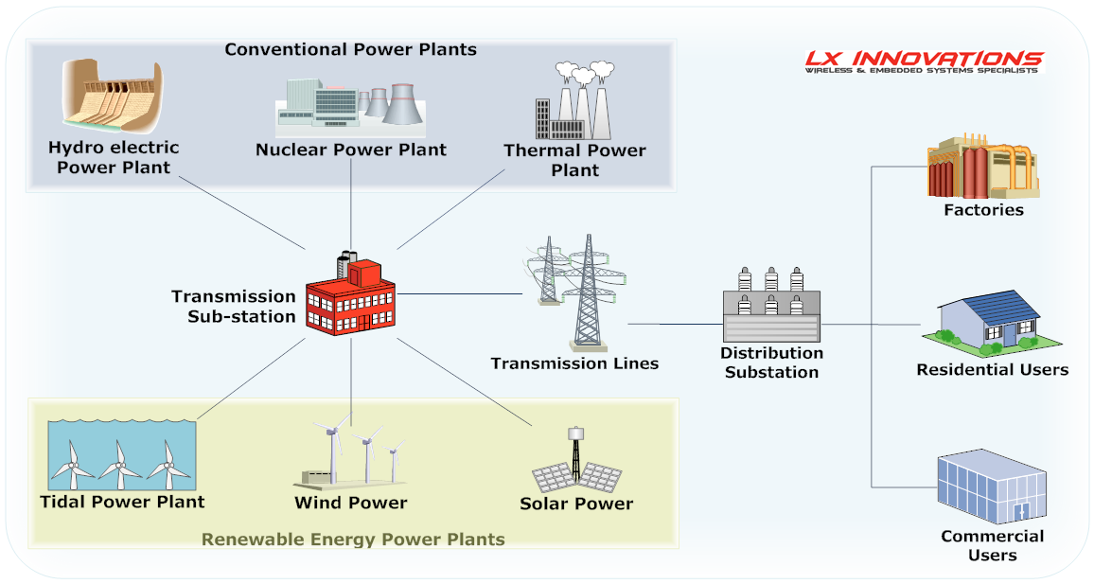
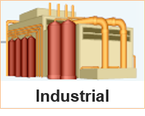

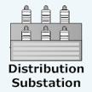
NOx REDUCTIONS USING eGRID
NOx emissions reductions calculation from electricity savings
_{CONSUMPTION}
  Energy Savings from EE/RE Programs
  Residential
  Commercial
  Industrial
_{TRANSMISSION & DISTRIBUTION}
  Transmission Lines
  Sub-Station
_{GENERATION}
  Energy Production & Emissions Reductions
  Conventional
  Renewable

Slide 26
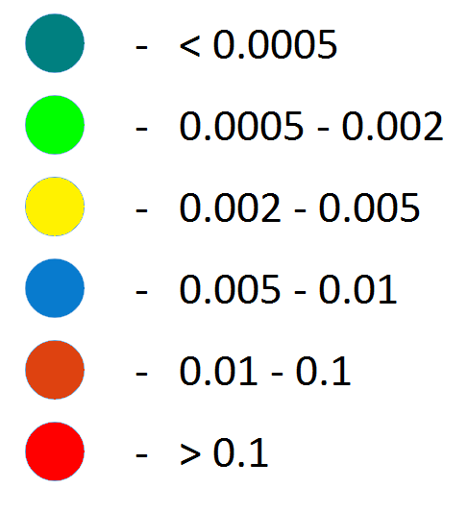
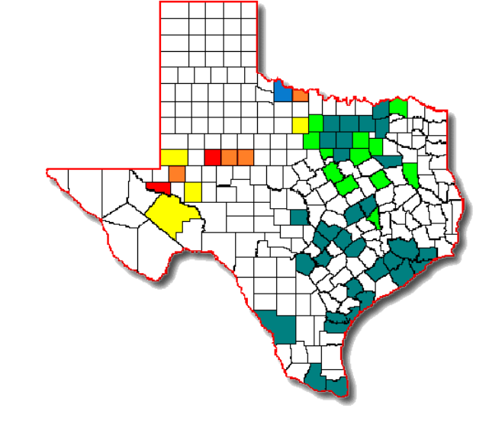
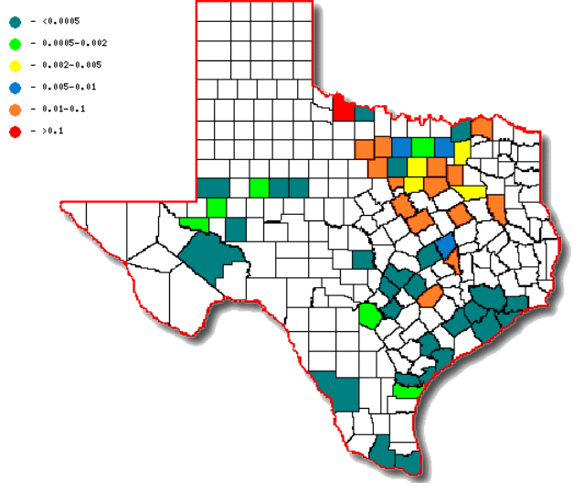
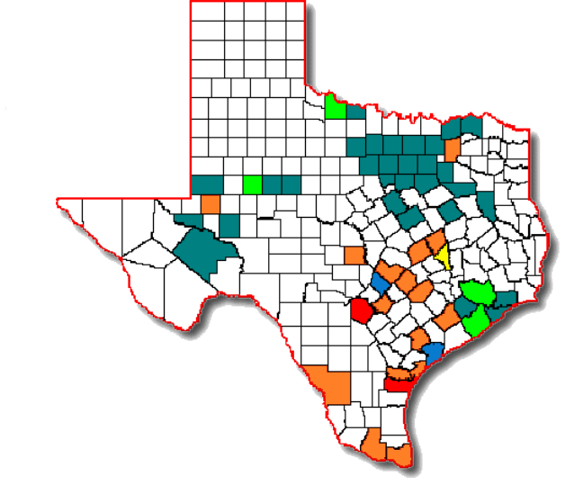
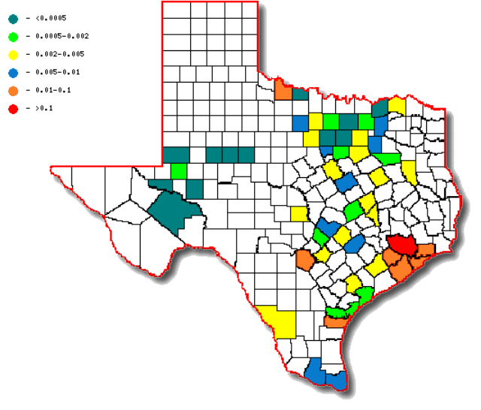
2010 eGRID for NOx Emissions
2010 Annual eGrid for NOx Emissions
Unit: lbs of NOx/MWh
West Zone
North Zone
South Zone
Houston Zone
Notes:
The 2010 eGrid table describes distribution of the NOx emission reductions per CM zone for each county in Texas.
Images show the same county-wide NOx emissions distribution from West, North, South, and Houston, respectively.

Slide 27
2016 eGRID for NOx Emissions
2016 eGRID (Annual) for NOx Emissions
Unit: lbs of NOx/MWh
West Zone
North Zone
South Zone
Houston Zone
Notes:
This is our new eGRID from 2010 eGRID.
The 2016 eGrid table describes distribution of the NOx emission reductions per CM zone for each county in Texas.
Images show the same county-wide NOx emissions distribution from West, North, South, and Houston, respectively.

Slide 28
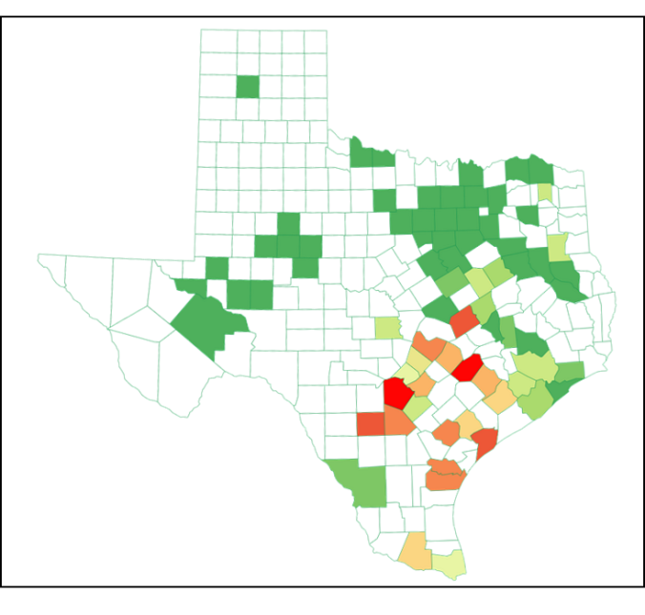
2016 eGRID for NOx Emissions
2016 eGRID (OSP) for NOx Emissions
Unit: lbs of NOx/MWh
West Zone
North Zone
South Zone
Houston Zone

Slide 29
NOx REDUCTIONS FROM WIND POWER
OSP Power Generation and NOx Emissions Reductions (2008 base year)
156,253

Slide 30
NOx REDUCTIONS FROM WIND POWER
OSP Power Generation and NOx Emissions Reductions (2008 base year)
Notes:
2009 – 2016 OSP Nox Emissions were calculated using 2010 eGRID which was developed based on EPA scenario.
2017 OSP Nox Emissions were calculated using the new 2016 eGRID that was developed based in part on real data.

Slide 31
SAVINGS FROM OTHER RENEWABLES
(2001-2017)
Renewables: Biomass, Hydro, Landfill Gas, Solar, Wind
Wind energy is the largest portion
Excluding Wind
69,473 GWh
Biomass (216 GWh)
Hydro (444 GWh)
Landfill
(446 GWh)
Solar (2,289 GWh)
Notes:
This data is from "ERCOT's Renewable Energy Credit Program Information (REC)".

Slide 32
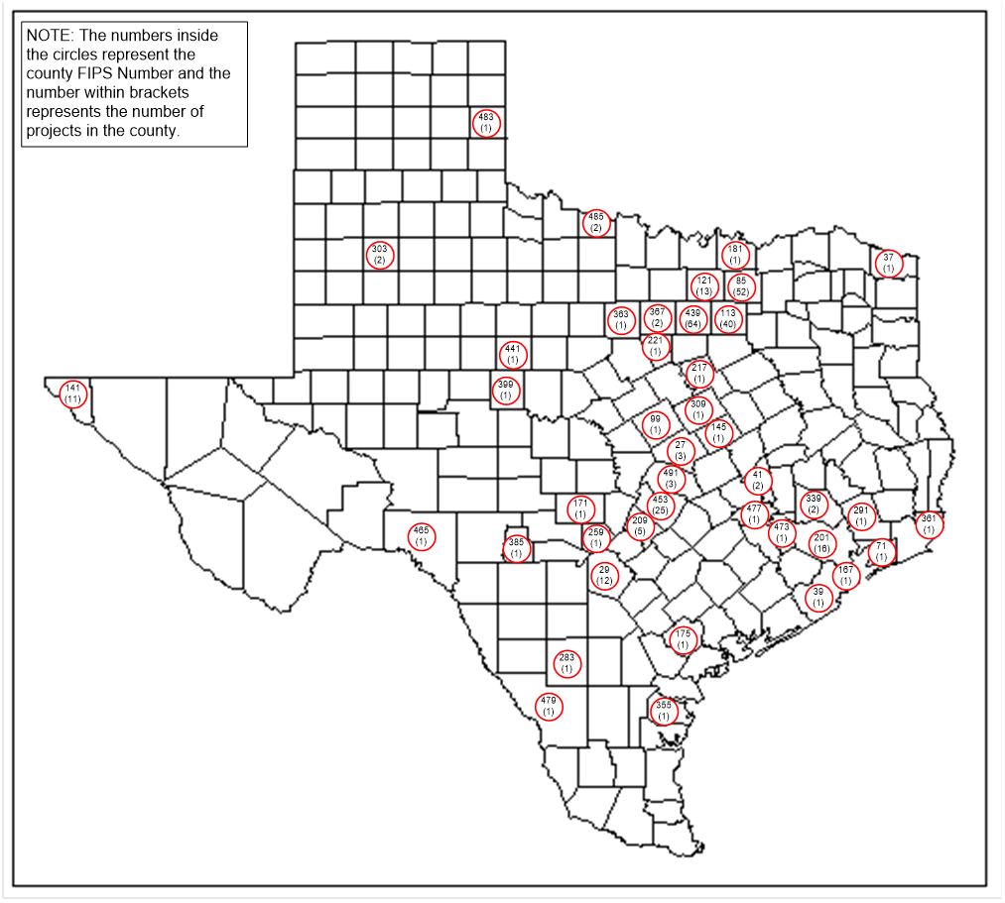

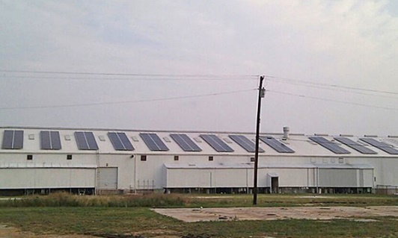
RENEWABLE PROJECTS IN TEXAS (2017)
Geothermal
Renewables*:
Solar PV - non utility scale
(4,784 projects (92.3%))
Solar PV- utility scale
(32 projects (0.6%))
Biomass (14 projects (0.3%))
Hydro (29 projects (0.6%))
Geothermal (286 projects (5.5%))
Landfill Gas (38 projects (0.7%))
Landfill Gas
Hydro
Solar PV
Biomass
Solar Pv - non utility scale
2.5 Miles Southwest of Woodville, TX
Blue Wing Solar PV Array ,San Antonio
Dam at Elephant Butte, El Paso, TX
Ground Source Heat Pump
Aspen Power plant in Lufkin, TX
https://openpv.nrel.gov
* Included renewable projects if their information/data are available
Notes:
Solar PV – non utility scale : NREL data
Solar PV – utility scale : ERCOT data
Biomass : ERCOT data
Hydro : ERCOT data
Geothermal : data from various websites (geothermal HVAC industry related)
Landfill gas : EPA data

Slide 33
ENERGY SAVINGS FROM PUC SB7
PUC SB7 Savings and Projections
The Public Utility Commission of Texas (PUC) Senate Bill 7 program includes their incentive and rebates programs managed by the different Utilities for Texas.
These include the Residential Energy Efficiency Programs (REEP) as well as the Commercial & Industrial Standard Offer Programs.

Slide 34
ENERGY SAVINGS FROM SECO
SECO Savings and Projections
The Texas State Energy Conservation Office (SECO) funds energy-efficiency programs directed towards school districts, government agencies, city and county governments, private industries and residential energy consumers.
The annual electricity savings are obtained from SECO’s energy conservation projects reported by political subdivisions for 13 counties.
Notes:
13 county data were used for this year (2017) savings.
28 counties have reported since 2009.

Slide 35



INTEGRATED NOx EMISSIONS REDUCTION
Integrated Emissions Savings Across Agencies To Report Savings To TCEQ and EPA
State agencies included:
  - TEES/ESL
  - PUC
  - SECO
  - ERCOT/Wind
  - SEER 13/14 Single/Multifamily
  Total savings across agencies
  Annual emissions reductions:
  - By program
  - By county
  - By SIP area
  - By ERCOT counties
  - By City and Surrounding Area within a 200km Radius

Slide 36
INTEGRATED NOx EMISSIONS REDUTION
(2008 Baseyear)
2017 Integrated OSP NOx Emissions Reduction Using new 2016 eGrid
96.93 tons/day
73.93 tons/day
34.28 tons/day
2016 integrated OSP NOx Emissions Reduction
    ESL Code Compliance (1.87 tons/day)
    PUC SB7 programs (2.39 tons/day)
    SECO Political Sub.* (0.67 tons/day)
    Green Power (Wind) (28.91 tons/day)
    Residential AC Retrofits (0.43 tons/day)
    Total (2016) (34.28 tons/day)
2017 integrated OSP NOx Emissions Reduction
    ESL Code Compliance (2.89 tons/day)
    PUC SB7 programs (3.75 tons/day)
    SECO Political Sub.* (1.45 tons/day)
    Green Power (Wind) (65.32 tons/day)
    Residential AC Retrofits (0.52 tons/day)
    Total (2017) (73.93 tons/day)
2020 integrated OSP NOx emissions reduction
    ESL Code Compliance (5.58 tons/day)
    PUC SB7 programs (4.65 tons/day)
    *SECO Political Sub. (2.81 tons/day)
    Green Power (Wind) (83.43 tons/day)
    Residential AC Retrofits (0.45 tons/day)
    Total (2020) (96.93 tons/day)
Notes:
2009 – 2016 OSP Nox Emissions were calculated using 2010 eGRID which was developed based on EPA scenario.
2017 OSP Nox Emissions were calculated using the new 2016 eGRID that was developed based in part on real data.

Slide 37

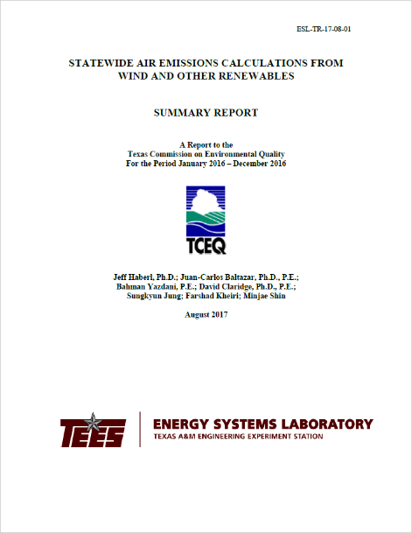
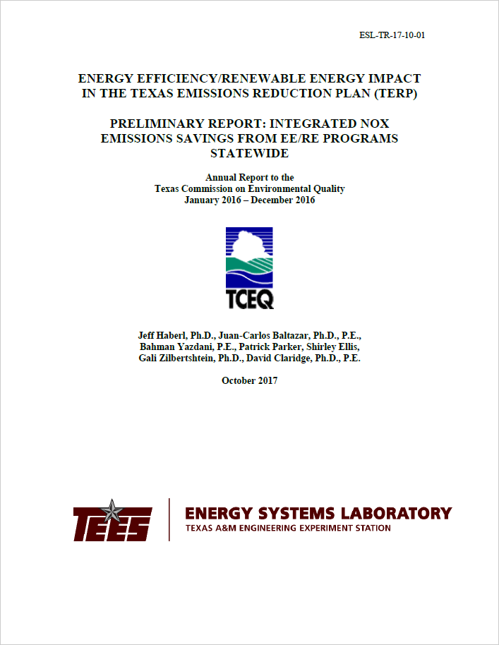


REPORTS AND PAPERS: TERP
Reports: 2002 through 2018
Recent Reports:
Statewide 2017 Air Emission Calculations from Wind and Other Renewables
TCEQ 2017 Annual Preliminary Report: Integrated NOx Emissions Savings from EE/RE Programs Statewide
TCEQ 2017 Annual Report Volume I: Technical Report
TCEQ 2017 Annual Report Volume II: Technical Appendix

Slide 38







REPORTS AND PAPERS: TERP
Publications: 2017
Dissertation 2017:
Oh, S. “Quantifying the Electricity Savings from the Use of Home Automation Devices in A Residence,"PhD., Department of Architecture, December 2017.
Papers 2017:
Do, S., Haberl, J.S., 2017. “Development of a Ground-coupled Heat Pump System Simulation Model Using G-function Approximation for a Residential Code-compliant Tool.” Building Simulation.
Do, S., Shin, M., Baltazar, J., Kim, J. 2017. "Energy Benefits from Semi-transparent BIPV Window and Daylight-dimming Systems for IECC Code-Compliance Residential Buildings in Hot and Humid Climates", Solar Energy, Vol.155, pp.291-303, (June).
Kim, H., Haberl, J. 2017. “Field Test of the ASHRAE/CIBSE/USGBC Performance Measurement Protocols: Part I - Intermediate Level Protocols”, Science and Technology for the Built Environment, (September).
Kim, H., Haberl, J. 2017. “Field Test of the ASHRAE/CIBSE/USGBC Performance Measurement Protocols: Part II – Advanced Level Protocols”, Science and Technology for the Built Environment, (September).
Shin, M., Baltazar, J.C, Haberl, J, Frazier, E., Lynn, B. 2017. “Side-by-side Tests of a Net-zero Energy Building”, Building Simulation 2017 Conference, International Building Performance Simulation Association, United States Chapter, August.
Song, S., Haberl, J. 2017. “Simplified Field Measurement and Verification of Global Solar Transmittance for Glazing Samples Under Natural Clear-Sky Conditions”, Solar Energy, Vol. 155, pp. 706 – 714 (July).

Slide 39

U.S. AIR QUALITY IMPROVEMENT FROM
2005 - 2017
Source from NASA: http://www.nasa.gov/content/goddard/new-nasa-images-highlight-us-air-quality-improvement/#.U_-CNxzKbxQ

Slide 40

ESL Contact Information
Contact Information:
Jeff Haberl: jhaberl@tamu.edu
Bahman Yazdani: byazdani@tamu.edu
http://esl.tamu.edu/terp
Contact Information:
Jeff Haberl: jhaberl@tamu.edu
Bahman Yazdani: byazdani@tamu.edu
Juan-Carlos Baltazar: jbaltazar@tamu.edu
http://esl.tamu.edu/terp

