Slide 1


Slide 2
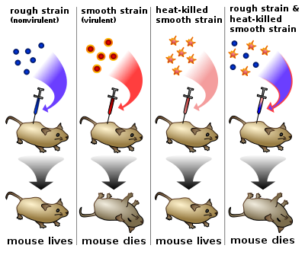
S vs. R Pneumococcal Strains

Slide 3
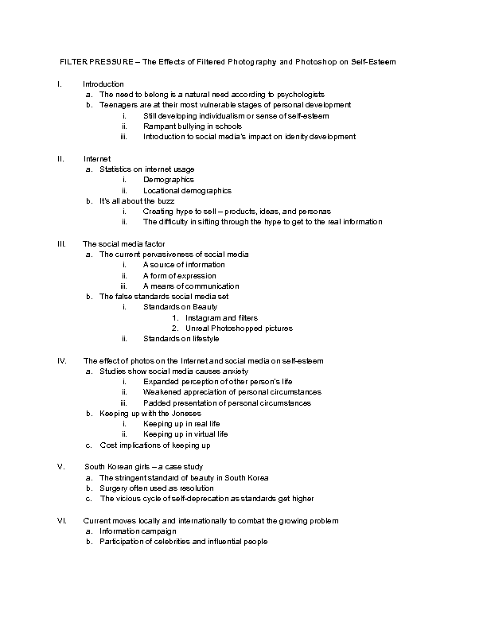
Is this what “outline” brings to mind?
I don’t blame you if you reject such barbaric practices!

