Slide 1

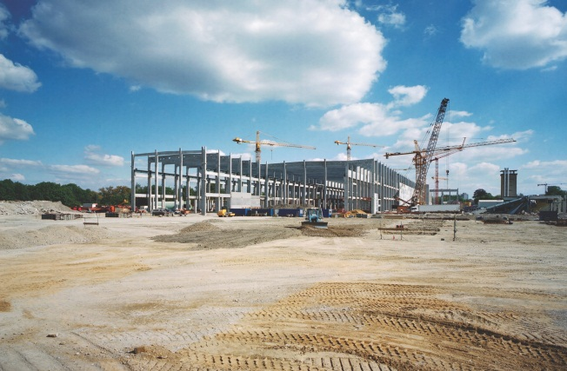

CATEE Conference
Energy Efficiency by the Book – IECC 2018
Requirements and
Performance Simulation
Gerald J Kettler, PE, CCP, BEMP, LEED Fellow
Facility Performance Associates

Slide 2
Building Codes by International Code Council
Building Code
Mechanical Code
Plumbing Code
Energy Code – based on ASHRAE 90.1
Green Code –soon to be based on ASHRAE 189.1

Slide 3
Building Code – IBC 2015
International Building Code - 2015 includes Special Inspector Requirements ‘to verify proper commissioning of Smoke Control Systems’ in Section 909.3.
Commissioning shall be by accepted engineering practice and published standards.
1703 Approved agency qualifications include: independence, adequate calibrated equipment, experienced personnel
No ASHRAE Standards are referenced
IBC-2018 = No changes to Commissioning requirements

Slide 4
International Mechanical Code – 2015
Section 513.3 refers to special inspection to verify proper Commissioning of Smoke Control Systems as in IBC section 909
Commissioning shall be IAW generally accepted engineering practice and published standards.
ASHRAE Standards referenced = 15, 34, 62.1, 170, 180
IMC -2018 = No changes to Commissioning requirements

Slide 5
2015 IECC = MODEL CODE
Is a Design Document
Covers New and Existing Buildings
Residential and Commercial Code Sections
Regulates Minimum Energy Conservation - Includes:
  Building Enclosures
  Heating and Ventilation
  Water Heating
  Lighting
  Power usage of Appliances and Systems

Slide 6
Code and Standard Comparisons
ASHRAE Standard 90.1-2013 = 38% more efficient that 90.1-2004
IECC 2012 = 30% more efficient than IECC 2006

Slide 7
2015 IECC Chapters
1 & 2. Scope and Definitions
3. General Requirements, Climate Zones
and Materials Requirements
4. Energy Efficiency
  Envelope, Mechanical, Water Heating,
  Power, Lighting
  Total Building Performance
5. Existing Buildings
6. Referenced Standards

Slide 8
Design Conditions
Residential and Commercial
Sect. 302: The interior design temperatures used for heating for heating and cooling load calculations shall be a maximum of 72 F for heating and minimum of 75 F for cooling
Sect. 303: Insulation Labeling and Rating, Fenestration Product Rating

Slide 9
2015 IECC - Commercial
Commercial buildings must comply with either:
  1. ASHRAE 90.1-2013
  2. PERSCRIPTIVE: C402-Building envelope, C403 Mechanical Systems, C404 Service Water Heating, and C405 Electrical Power and Lighting and C406 Performance Packages, C406.1.1 for Tenant Spaces
  3. PERFORMANCE: Sections: C402.5, C403.2, C404, C405.2, C405.3, C405.4, C405.6 and C407. and building energy use shall <85% standard building

Slide 10
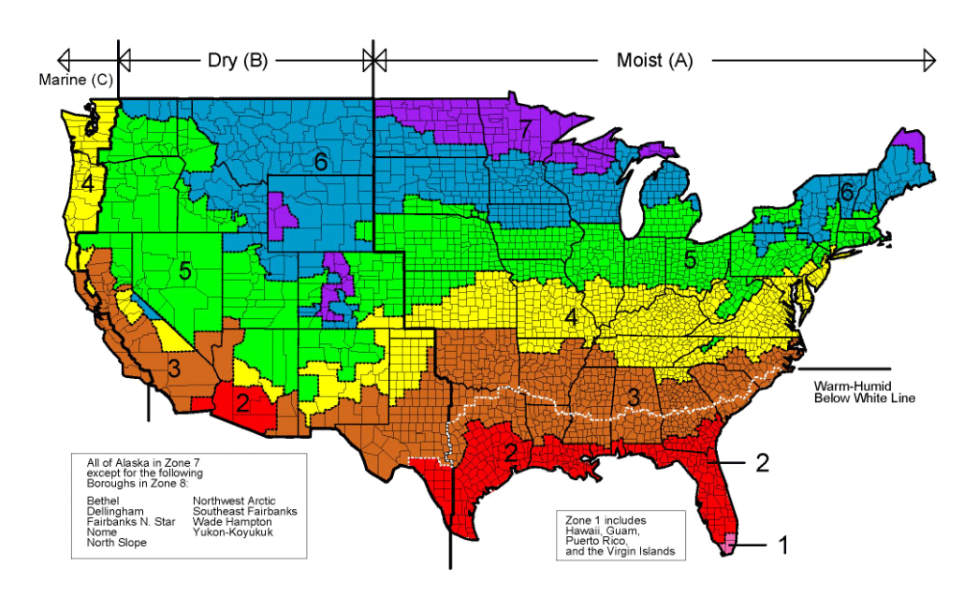
Climate Zones

Slide 11
Commercial – Envelope – Zone 3
Roof-insulation above deck = U of .039 ci
  Insulation on ceilings not included
Walls above grade – Mass = U of .123
Metal Framed = U of .064
Floors -Mass= U of .076
Slab on grade = U of .730
Fenstration – Curtain wall = U of .46,
SHGC = .25 to .40 depending on PF & direction
Skylights = U of .55, SHGC = .35

Slide 12
2015 IECC- Commercial – Envelope
Fenstration limited to 30% of above grade walls
    Up to 40% with day lighting requirements
Skylights limited to 3% of roof with auto day lighting controls
Buildings >2500 S.F. and ceiling height >15 feet must have 50% day lighting
  Multiple options and restrictions
Dynamic Glazing options
Continuous Air Barriers required.

Slide 13
2015 IECC Commercial
Outdoor air intakes and exhausts shall be equipped with Class 1 motorized, leakage rated dampers. Gravity dampers allowed in buildings in Zones 1, 2 and 3 with limitations.
Vestibules required on outside doors with some exceptions.
Loading docks and cargo doors require weather seals.
Recessed lighting shall limit air leakage

Slide 14
2015 IECC Commercial-Mechanical
C403.2.1 Design Load Calculation shall be determined by procedures in ASHRAE Standard 183, Peak Cooling and Heating Load Calculations
C403.2.2 Equipment and system sizing – Heating and cooling equipment and systems capacity shall not exceed the loads calculated in Section C403.2.1

Slide 15
2015 Commercial Equipment Efficiency
Air cooled Pkg– 14.0 SEER (5 Ton and less)
Air cooled Pkg – 12.8 IEER (5 to 10 Ton)
Water cooled Pkg– 13.9 IEER (5 to 10 Ton)
Water source HP– 13.0 EER at 86 F entering water
Ground source cooling HP– 18 EER at 59 F entering water
Warm air furnace – gas- 80%
Boiler –hot water– gas fired – 80%

Slide 16
2015 IECC Commercial Controls
Each heating or cooling zone shall have a thermostat
Humidistat is required if humidity control is required.
Set-point overlap – dead band of >5F required
Setback and shut down controls required and must capable of 55F to 85F for 7 different schedules and have battery backup and manual overr1ide
Optimum start controls required.
Zone isolation required.
Air cooled and VRF units require economizer fault detection.

Slide 17
2015 IECC – Commercial Ventilation
Ventilation is required per Chapter four of International Mechanical Code
Demand control ventilation is required for spaces larger than 500 feet and with an occupant load of > 25 people per 1000 sq.ft.
Energy recovery systems are required on systems with limitations and exceptions.
Kitchen exhaust, makeup air and controls

Slide 18
2015 IECC Commercial
Supply and return ducts shall be insulated with R-6 or greater inside and R-8 outside.
Duct insulation and sealing – built to IMC 603.9
  Low pressure < 2” wg
  Medium pressure 2” to 3” wg
  High pressure >3”wg Must be tested to SMACNA test manual, designer must furnish documentation demonstrating that representative samples > 25% have been successfully tested
Piping must be insulated per Table C403.2.10

Slide 19
2015 IECC Commercial
Allowable fan horsepower design conditions are limited with exceptions.
Fan efficiency must have FEG <67 w/exceptions
Economizers are required on most systems.
Hydronic and Multi-zone systems must use variable speed drives with exceptions
Static Pressure Sensor locations controlled and be <1.2 “wg.

Slide 20
2015 IECC Commercial
Multiple zone HVAC systems shall include temperature reset controls.
Zone isolation required in larger systems
Hot gas bypass systems have limitations.
Fractional HP motors must be ECM motors
Two pipe and three pipe systems have limitations

Slide 21
2015 IECC Commercial
Service Water Heating
Service water heating with a recirculating pump shall have capacity controls
Service water heating piping shall be insulated
Limitations on unheated maximum pipe length
Service water heating systems shall have automatic or manual controls

Slide 22
2015 IECC Commercial Lighting (M)
Occupant sensor controls required in most rooms.
Light reduction controls required to reduce lighting power by at least 50%
Buildings shall have automatic shut off devices with schedules or occupancy sensors and manual over rides with 30 minute shut off and manual on.
Day lighting zones shall have specific controls
Exterior lighting shall have time switch or photo cell controls

Slide 23
2015 IECC Commercial Lighting
Exit signs shall not exceed 5 Watts per side
Interior lighting power is limited by function from .21 to 1.26 watts/sq.ft. by building area or .19 to 3.68 watts/sq.ft. by space method.
Exterior lighting power is limited by zone location

Slide 24
2015 IECC Commercial Power Systems
Individual living units must be metered.
Power transformers must have minimum efficiency and be rated.
Electric motors must have minimum efficiency and be rated.
Elevators and escalators must meet efficiency requirements

Slide 25
2015 IECC C406 Efficiency Package
Comply with one of the following
  1. Efficient HVAC performance per tables (+10%)
  2. Efficient Lighting Systems per table (-10%)
  3. Enhanced lighting controls
  4. On-site Renewable Energy
    1.75 Btu or .5 watts per Sq.Ft. or
    3% of energy for mechanical and service water heating
  5. Use of DOA system
  6. Use of high efficiency hot water system

Slide 26
2015 IECC - C407
Total Building Performance
Compliance with C402.5 Air Leakage, C403.2 Provisions of Mechanical Systems, C404 Service Water Heating , and C405 Electric Power and Lighting
Total building performance modeling (ASHRAE Std. 140 compliant) requires that the proposed building to have an annual energy cost less than or no higher than the standard reference design.
Detailed compliance documentation is required

Slide 27
2015 IECC Mechanical System Commissioning
Mechanical an Service Water Heating System Commissioning and Completion- Prior to final mechanical inspection, registered design professional or approved agency shall provide evidence of mechanical system commissioning and completion
  System size limitations
  Excludes hotel room and apartments

Slide 28
2015 IECC Mechanical System Commissioning
Commissioning Plan developed by registered design professional or approved agency
  Narrative of activities and personnel included
  Listing of equipment and systems
  Functions to be tested
  Test conditions
  Measurable criteria

Slide 29
2015 IECC Mechanical System Commissioning
  Functional Performance Testing – Equipment
    Installation and operation
    Sequence of operation
    Maintenance serviceability
  Controls and Economizers
    Calibrated
    Adjusted
    Operate to approved plans and specifications

Slide 30
2015 IECC Mechanical System Commissioning
Preliminary Commissioning Report (by Design Professional or Approved Agency) with deficiencies, deferred testing and conditions required.
    Owner shall certify receipt of the preliminary report prior to final inspection
    Code official can request a copy

Slide 31
2015 IECC Mechanical System Commissioning
Construction documents shall require documentation – Within 90 days of Certificate of Occupancy be delivered to owner:
  Record Drawings with performance data
  Systems Manual with submittals, O&M manuals, control system data with sequence of operation, service and maintenance data and schedules
  Systems Balancing Report
  Final Commissioning Report with testing results

Slide 32
2015 IECC Commercial
Lighting Commissioning-C408.3
Lighting system functional testing- Prior to final inspection, registered design professional shall provide evidence of lighting control system testing including hardware and software programming and adjustment.
  Occupant sensor controls
  Time switch controls
  Daylight responsive controls
Construction documents shall require a final report to owner within 90 days of CO.

Slide 33
2015 IECC - Existing Buildings
C502 Additions shall comply with new construction requirements
C503 Alterations shall comply with new construction requirements with some variations
C504 Repairs not normally required to comply.
C505 Change in Occupancy requires IECC compliance if energy use is increased

Slide 34
International Energy Conservation Code – 2018
C408.1.1 Building Operations and Maintenance Information - Replaces C408.2.5.2
- includes O&M information requirements
- adds equipment label with maintenance requirements and reference to O&M Manual
C408.2.4 Preliminary Cx Report
  adds figure 408.2.4 = checklist for Cx and approval form for owner signature
  Adds FPT procedures, measurable criteria and results

Slide 35
International Energy Conservation Code – 2018
C408.2.4.1 Acceptance of Report
  Adds report provided to AHJ
C408.3.2 Documentation Requirements (Lighting)
  Adds requirements to drawings including the location and catalog number for all equipment
  Adds O&M manuals for lighting
  Adds testing results and disposition of deficiencies for lighting

Slide 36
Why Simulation
  Methodology to Predict the Performance of Buildings
  Being Required by Codes
  Required by Green Building Programs
  Included in Integrated Design Processes
  Included in Design Standards

Slide 37
Building Codes and Standards
Building Codes
  Building, Mechanical, Plumbing, Electrical
Energy Codes
  Developed from research ASHRAE Standard 90.1
  Energy Code (IECC-2015)
Green Codes and Programs
  LEED, Green Globes, Living Building Challenge, 2030 Challenge, Etc.
  International Green Construction Code (IGCC-2015)
  ASHRAE 189.1 Standard for Deign of High Performance Green Buildings
  Local Green Codes

Slide 38
Industry Definitions
High Performance Building
Net Zero Building –
  Produces, over a years time, the same amount of energy it uses.
  Captures and uses the water so no City water is used.
  Other material use minimized

Slide 39
Design for High Performance
Define Performance = Owner Project Requirements
Integrate Design, Construction, Supplier, and Operations Functions and Professionals = True Design Teams:
Architects
Engineers
Manufacturers
Contractors
Operators
Commissioning and Verification of Performance
    Design
    Construction
    Commissioning
    Operations

Slide 40
Growth of Building Modeling and Simulation
Building HVAC, Plumbing and Electrical Design
Energy Modeling
Energy Program Compliance –
Energy Star, LEED
Flexibility in Design for Code Compliance – IECC, IGCC

Slide 41
Growth of Building Modeling and Simulation
Energy Use Index Programs –
DOE, Codes, Standards
Carbon Program Calculations –
Codes and Standards
zEPI Programs –
IGCC
Building Life Cycle Assessment –
IGCC

Slide 42
34 Texas Administrative Code §19.53
(b) All other residential, commercial, and industrial construction. Effective November 1, 2016, the International Energy Conservation Code, as it existed on May 1, 2015, is adopted as the energy code for use in this state for all residential, commercial, and industrial construction that is not single-family residential construction under subsection (a) of this section.
As published in the Texas Register- Jan. 1, 2016

Slide 43
Commercial Code Compliance
Choose
A
Path
IECC
ANSI/ASHRAE/
IES 90.1
Mandatory Provisions
Mandatory Provisions
Prescriptive
Path
Performance
Path
Prescriptive
Path
Performance
Path
Building Envelope
Mechanical
Total building performance
The building energy cost ≤85% standard reference design
Building Envelope
Mechanical
Energy Cost Budget Method
Service water heating
Service hot water
Power & Lighting
Power
Lighting
Other Eqmt
Add’l Eff Pkg
Certificates of Occupancy
Plan review
Construction
Inspection
Commissioning

Slide 44
Simulation Program
The simulation program shall be a computer-based program for the analysis of energy consumption in buildings (a program such as, but not limited to, DOE-2 or BLAST). The simulation program shall include calculation methodologies for building components being modeled. (ASHRAE Std. 90.1-2016, 11.4.1 and Appendix G 2.1)
The program must be approved by the AHJ.

Slide 45
Simulation Program Characteristics
A minimum of 1,400 hr/yr (AHRAE 90.1-2016, 11.4.1) or 8760 hr/yr (90.1 app G.2.2.1)
Hourly variations
Thermal mass effects
Ten or more thermal zones
Part load performance curves for mechanical equipment
Capacity and efficiency correction curves
Economizers with integral controls
Baseline building design characteristics
Provide design load calculations for proposed and baseline building
Program tested according to ASHRAE STD 140.

Slide 46
ENERGY MODELING: - the “THEORY”
    COMPUTERIZED SIMULATION OF BUILDING AND ENERGY USING SYSTEMS SUMMATION
    Expected Use Over Time
    Energy Costs and Potential Budgets
    Based on data and assumptions

Slide 47
ENERGY MODELING: - the “THEORY”
    ACCURACY of RESULTS DEPENDENT ON:
  Building Built as Designed
  AND
    Building Operations are Performed EXACTLY as Modeled

Slide 48
ENERGY MODELING: - the “THEORY”
    USES of MODELS
        Compare Total Energy Usage of Building Design to:
          ASHRAE Standard 90.1
          Local Code Minimum Baseline = COMCheck
      Compare Design Elements w/ common conditions
    Validate Design for:
      Local Code Compliance
      Green Program Ratings
      Tax Programs

Slide 49
COMMERCIAL BUILDINGS -USE OF ENERGY
    ENERGY USAGE FACTORS
      Human Comfort / Interior Occupation Load
      Weather =Exterior Loads = Walls, Windows, Doors, Roofing
      Water Heating
      Fresh and Ventilation Air
      Interior and Exterior Lights
      Plug Loads
      Equipment Loads

Slide 50
  ENERGY MODELING: SOFTWARE OVERVIEW
LEED® ACCEPTED SOFTWARE
        DOE 2 Engine
        E Quest
        Energy Ten
        Energy Gauge
        DOE Energy Plus
        Proprietary Programs
          Trane Trace
          Carrier HAP
          Tx A&M IC3

Slide 51
Energy Use Index (EUI) Programs
EUI = (AEU consumed –AEU generated)/TCFA
  AEU consumed = annual energy used on site as source energy
  AEU generated = annual energy use generated on site
  TCFA = total conditioned floor area.
  Note: usages are adjusted by source of energy based on power source and area of country. Example the ERCOT number is 3.08.
EUI = K BTU/sq ft/year
EUI can be used as a qualification limit number as in 50K BTU/sq ft/year or to develop a % number compared to baseline as in the CBECS system. Example: for our area 3A the reference number for an office building is 151.

Slide 52
Carbon Program Calculations
Annual direct and indirect CO2e equivalent emissions associated with the building EUI.
CO2e <_ (CO2er x zEPI)/100
  CO2er = Reference carbon emissions for site to evaluate the building impact for greenhouse gases and global warming potential.
Used to report building compliance and takes advantage of on site generation.
IGCC code requires annual reporting of CO2e to building official

Slide 53
zEPI Programs
zEPI = zero Energy Performance Index
zEPI = 100 (EUIa / EUIr)
  EUIa = Actual building energy use as modeled or measured
  EUIr = Reference energy use from IGCC table 612.1
IGCC code uses 52 as the target standard

Slide 54
Building Life Cycle Assessment
Building LCA = a compilation and evaluation of the inputs, outputs, and potential environmental impacts of building systems through the building life cycle. LCA addresses the environmental aspects and potential environmental impacts (e.g., use of resources and environmental consequences) from raw material acquisition through manufacturing construction, use, operation, end-of-life treatment, recycling, and final disposal

Slide 55
HIGH PERFORMANCE SIMULATION
PROJECT SUMMARY
  All Requirements Defined
  Integrated Design for All Systems
  Energy Use Modeled to Meet Codes and Requirements
  Construction Meets Design
  Performance is Verified - Commissioned
  Operations Defined and Operators Trained
  Project is Documented

Slide 56
Questions?
Gerald J Kettler, PE, CCP, BEAP, BEMP, LEED Fellow
Facility Performance Associates
GJKETTLER@ATT.NET
CATEE Conference

