Slide 2
Ethics in social science research
Notes:
In preparation for today’s class, students were to complete CITI training and send me their certificates of completion.
Additionally, students were assigned the following readings:
The Belmont Report. The National Commission for the Protection of Human Subjects of Biomedical and Behavioral Research;1979.
WMA Declaration of Helsinki-Ethical Principles for Medical Research Involving Human Subjects. Helsinki, Finland1964.
Taylor M. Desperate Quest For Herpes Cure Launched 'Rogue' Trial. Kaiser Health News. 2017.
Taylor M. Years Before Heading Offshore, Herpes Researcher Experimented On People In U.S. Kaiser Health News. 2017.
Taylor M. St. Kitts Launches Probe Of Herpes Vaccine Tests On U.S. Patients. Kaiser Health News. 2017.
Taylor M. Offshore Human Testing Of Herpes Vaccine Stokes Debate Over U.S. Safety Rules. Kaiser Health News. August 28, 2017.
Statement in Response to Rational Vaccines' Clinical Trial [press release]. SIU School of Medicine2018.

Slide 3


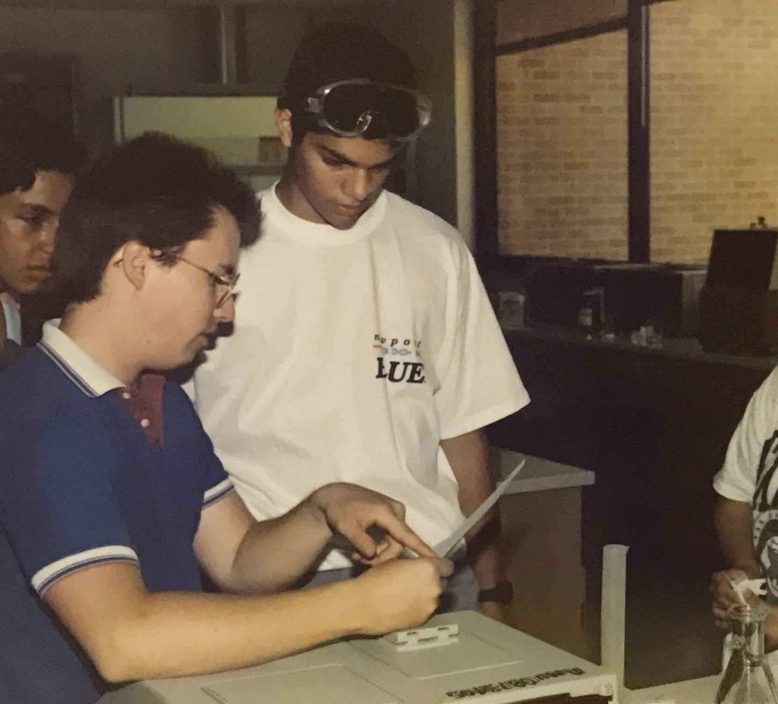



In the way, way back time…
Notes:
I got a very early start in bench research, starting my freshman year at A&M. For most of my adult life, that was my world.

Slide 4
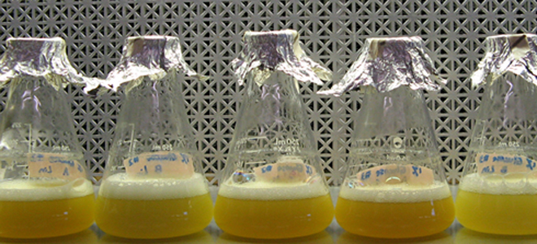
I was a tyrant!
And no one cared!
Notes:
I needed no special approval to do my research, no oversight apart from what funding agencies required in terms of progress reports. Of course, I had responsibilities in terms of proper handling and disposal of agents, but I had zero ethical considerations regarding my test subjects.

Slide 5
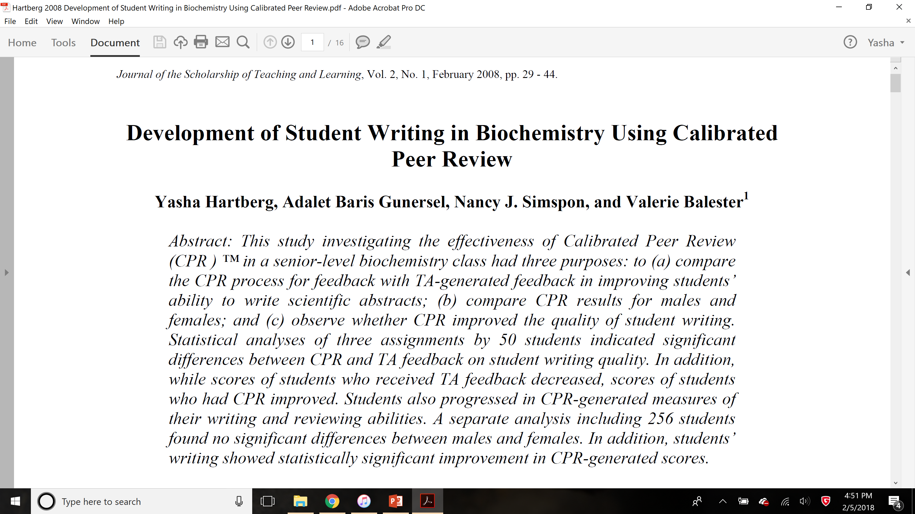
And then this happened…

Slide 6
IR-What?

Slide 7
What do you mean I can’t write “Texas A&M” in our paper?

Slide 8
What do you mean I should have gotten student permission first?

Slide 9
In short, I was thrown into the world of human subjects research for the first time.
And it was weird!
Notes:
And it wouldn’t be until several years later that I got official CITI training. As such, I didn’t have a context for this weirdness. I’d like to provide some of that for you today, both through our readings and through our discussions.

Slide 10
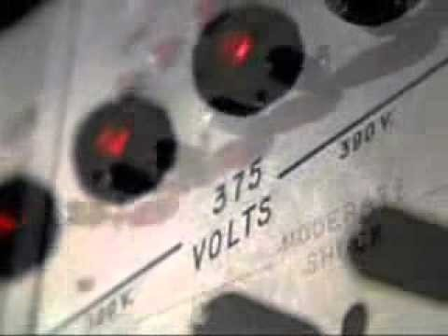
Milgram Obedience Experiment
Notes:
Points of discussion:
Is this experiment ethical? Why or why not?
Given that no one was actually injured, was there harm done? If so, what was the harm?
Was the level of deception used by Milgram justified? Under what circumstances would this level of deception be justified?
How could the harm done have been mitigated? Could it have been mitigated?
Milgram and others agree that this experiment could never be done today, but they also insist that Milgram uncovered a universal truth. What do you think of this universal truth? Is it a truth valuable enough to justify the harm done? Is it even a universal truth? Or is it, rather, a truth of people living in western societies? Does that change the calculus of whether this experiment was justified?

Slide 11
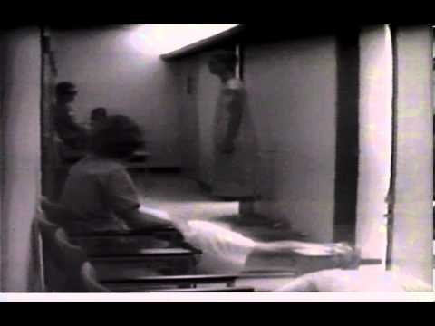
Stanford Prison Experiment
Notes:
Points of discussion:
Is this experiment ethical?
Is it ethical to cite this experiment or to use its findings?
In what contexts?
Is Zimbardo correct that enough good has come out of this experiment to justify the harm it did?
Is it ethical to use this experiment for teaching purposes? If so, in what contexts?

Slide 12
From experiments like these arose:
Declaration of Helsinki
Belmont Report
Notes:
Point out that American sources like to tie the development of these texts to the atrocities of Nazi Germany. Nazi Germany absolutely figured strongly in the development of research ethics, but American scientists were doing pretty awful things long before the likes of Mengele came to our attention. (Tuskegee Syphilis Experiment, for instance, started in the 1930’s and proceeded for 40 years. We had scientists trying classical conditioning on infants in the 1920’s, etc.)
I had you read these because it’s a crime that no one goes back to the primary sources any more. These may be dry reading, but they aren’t so long as to justify knowing about them only second hand.
What do these documents set out in terms of modern research?
How has the United States research community responded to these documents? (IRB and the review process).

Slide 13
And yet…
William Halford and Rational Vaccines
Notes:
Research of questionable ethics is hardly a thing of the past.
What are some of the ethical problems with bypassing the IRB process by going offshore?
Patients were informed and they consented. They were compensated for their time. They were active and willing participants. So what’s the harm?
Harm to patients.
Harm to university.
Harm to shareholders.
If Rational Vaccine’s approach does work, should it be used in light of these ethical violations? If so, who should profit? Would rewarding a patent on this vaccine encourage other drug companies to bypass IRB?

Slide 14
Role of science reporter?
Notes:
What is the role of the science and technology journalist in research ethics?
What are harms that come from reporting scientific misconduct?
Are those harms outweighed by the public interest? By the exposure of harms done to participants?
My hope is that considering these original documents and some of the cases that motivated them as well as having your undergo part of the CITI training will give you valuable insight in your reporting of science. And, of course, for those of you who want to do a thesis option, this is a good down payment on training you have to do anyway.
Take home point: Science has enough mindless boosters among journalists. Never forget that an important role of the fourth estate is to protect the public interest and never be afraid to report when scientists don’t play by the rules. It’s part of your own ethical mandate!

Slide 15
Next week
Chapter 5: Qualitative Research Methods
Field Observation
Justin, Sarah, and Rachel
Focus Groups
Ava, Danielle, and September
Case Studies
Meggy, Jennifer, and Jana
Ethnography
Mo and Emma
Notes:
Next week will be very student driven.
You’ve been each assigned to a particular qualitative methodology discussed in chapter 5 of Media Research. As a group, you’ll lead the class discussion on that methodology.
To help illustrate your points, I’d like each of you to find a research article relevant to communication or journalism that uses the methodology you’ve been assigned. You should read your article in enough depth that you can discuss the research questions, the methodology, and the major findings of your study. Although it’s unlikely you’ll find exactly the same articles, you should coordinate your efforts with others who were assigned the same methodology to be sure you’re not covering exactly the same articles.

