Slide 1



Slide 2
Move Analysis
Would someone please tell me what to write?

Slide 3
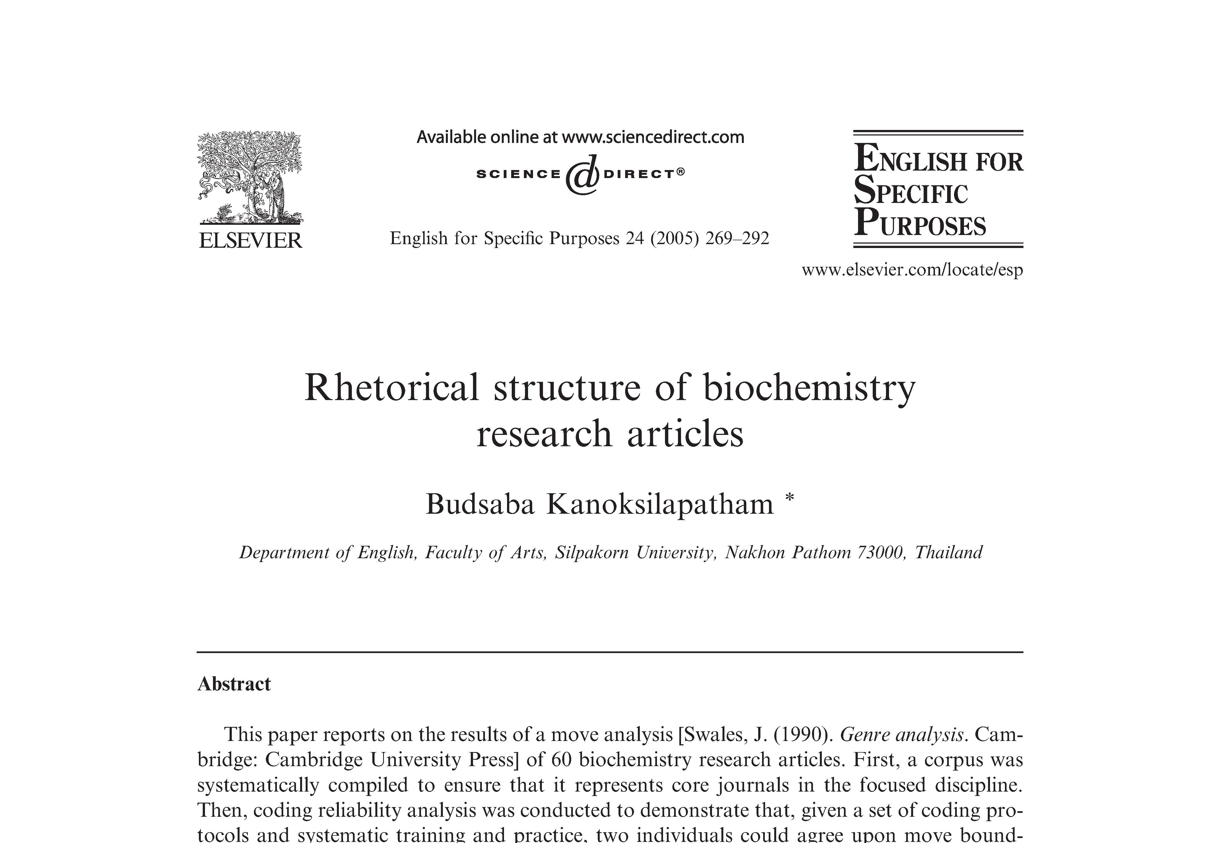

Slide 4
Move Analysis
Rhetorical analysis of genres
Looks for predictable patterns
Identifies stretches of text, called moves, that serve specific functions
Breaks those moves into shorter “steps”

Slide 5

A bit Like Acts and Scenes in Plays

Slide 6
Do Literature Reviews Follow predictable Patterns?

Slide 7
Yes!

Slide 8
Move 1: Announcing the importance of the field
With 3 possible steps

Slide 9
Step 1: Claiming centrality
Protein degradation plays an important role in a wide array of cellular events.
Iron-sulfur (Fe-S) cluster prosthetic groups play a key role in a wide range of enzymatic reactions, as well as serving as regulatory switches.

Slide 10
Step 2: Making topic generalizations
The hammerhead ribozyme is arguably the best-characterized ribozyme
Protein export pathways are less well characterized, although…

Slide 11
Step 3: Reviewing previous research
Double-stranded RNA induces potent cellular responses in diverse biological systems…
The movement of lipid and protein components between intracellular organelles requires the regulated interactions of many molecules…

Slide 12
Move 2: Preparing for the present study
With 2 possible steps

Slide 13
Step 1: Indicating a gap
The mechanism of processing the mature, 184nt 6S RNA from its precursor has not been characterized…
Consequently, how related the serotonin N-acetyltransferase catalytic mechanism will be to that of other superfamily members is unclear…

Slide 14
Step 2: Raising a question
The key (as yet unresolved) questions in analysis of dsRNA-associated PTGS are (1) Why are both strands required in the trigger RNA? And (2) How can dsRNA exert an effect at concentrations that are substantially lower than those of the endogenous target RNA?
Is conformational stability a determinant of ribonuclease cytotoxicity?

Slide 15
Moves and steps are guidelines
They are not absolutes!
Organize your literature review in a way that makes sense for your project

Slide 16
FAQ: Is the literature review just an extension of my memo?
Not exactly
  Not in memo format
  The literature review will be formal (no contractions, no first person singular, etc.)

Slide 17
FAQ: Can I use material I wrote for my memo?
Absolutely!
Be careful, though, to avoid informal language, contractions, etc.

Slide 18
FAQ: Do I need to annotate my bibliography for the literature review?
No! In fact, you’ll lose points if you do.

Slide 19
FAQ: Do I need to cite 12 Primary references in my literature review?
Yes. You are, of course, free to cite more.
They do not have to be the same 12 references you used for your annotated bibliography.

Slide 20

A final note about structure

Slide 21
What you’re used to
General
Specific
Specific
General

Slide 22
What you’re going to end up with
General
And that’s going to feel weird!
But it’s totally okay.
Specific

